Slide 1

NSG Pilkington – University of Liverpool Machine Learning Project: 14/04/2021
Dr. Peter Green
Diego Echeverria
Sarini Jayasinghe
Risk Institute,
School of Engineering

Slide 2
Today
Linear regression (reduced inputs)
Clustering
Processing furnace faults
Time lag estimation

Slide 3
Linear Regression (Reduced Inputs)
Linear regression using the reduced inputs provided by the team.
Results not very different to before, and worse in some cases.
The rise in fault density from 6th – 9th September still isn’t captured by the model.
The inclusion of load and cullet rate-of-change inputs did not have significant impact either.
In the following we have trained the model using data distributed over the entire time period, using the reduced set of inputs.
This goes against the idea of future predictions, but it:
Helps give us a better idea of what inputs the model uses over the entire time period.
Helps us to see if lack of training data is preventing the model from capturing some important rises in fault density.

Slide 4
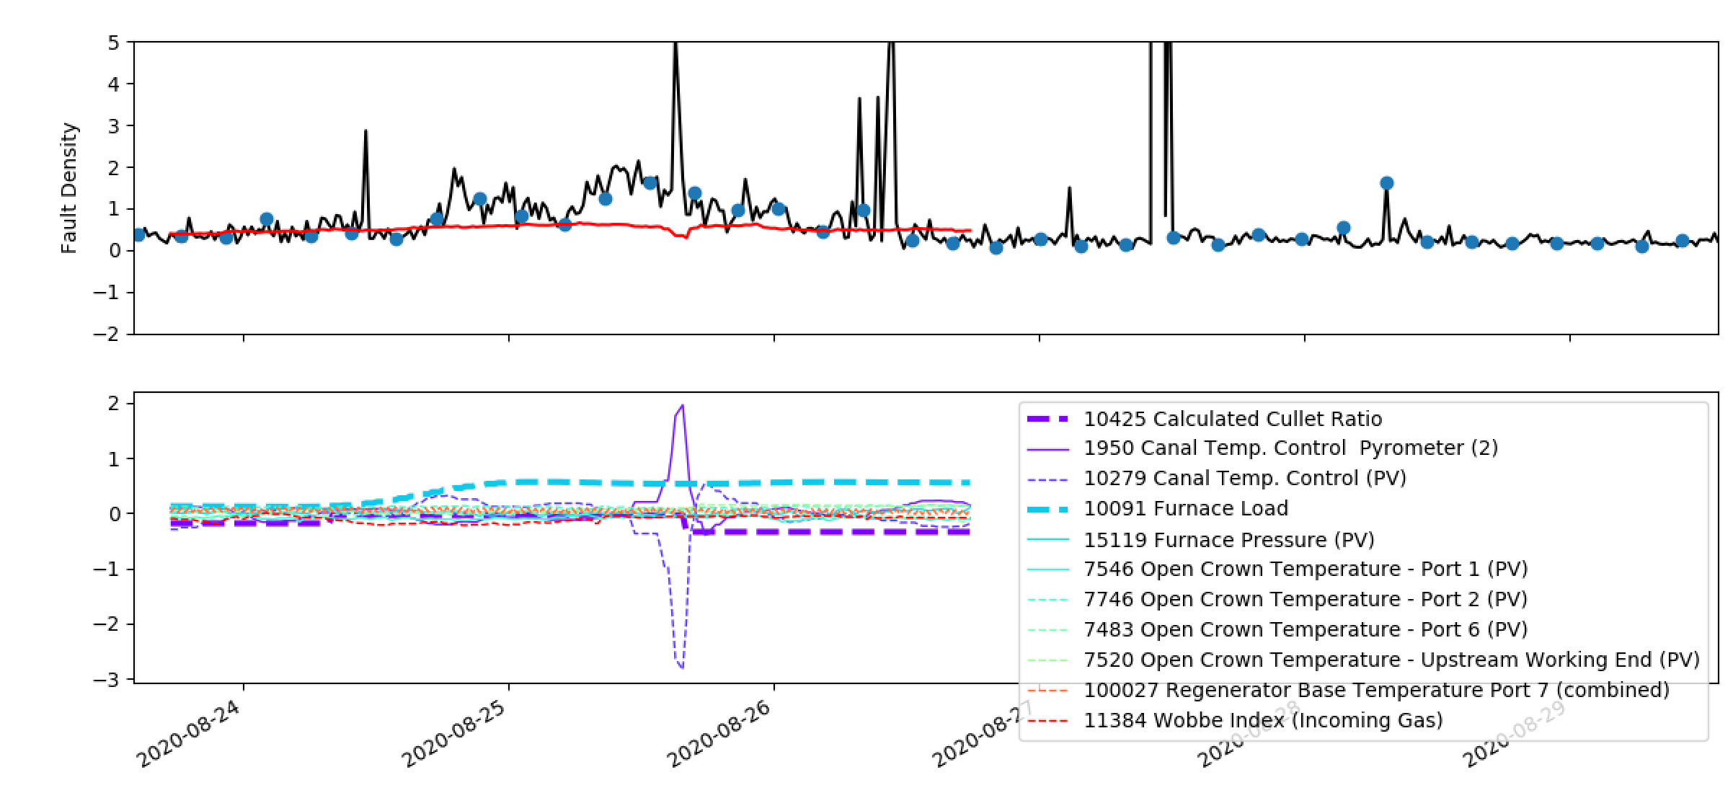
Linear Regression (Reduced Inputs)
Using training data over the whole domain; fluctuations are reduced but at the expense of capturing some of the rises in fault density. Symptom of time-varying nature and/or nonlinearity.
Period 1 (23rd August – 27th August)
(Training points)
This happens a lot – does this make sense?

Slide 5
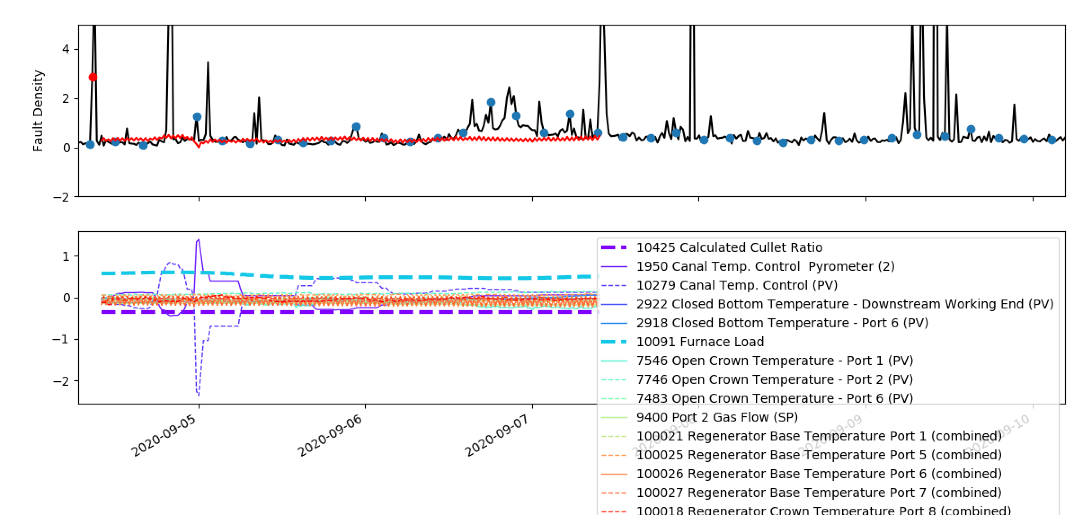
Linear Regression (Reduced Inputs)
Period 2 (6th September – 9th September)
Note we still don’t capture this even with training data in this region. A lot of complex things happen in this period – would be expect the model to be able to predict this?
This again…

Slide 6
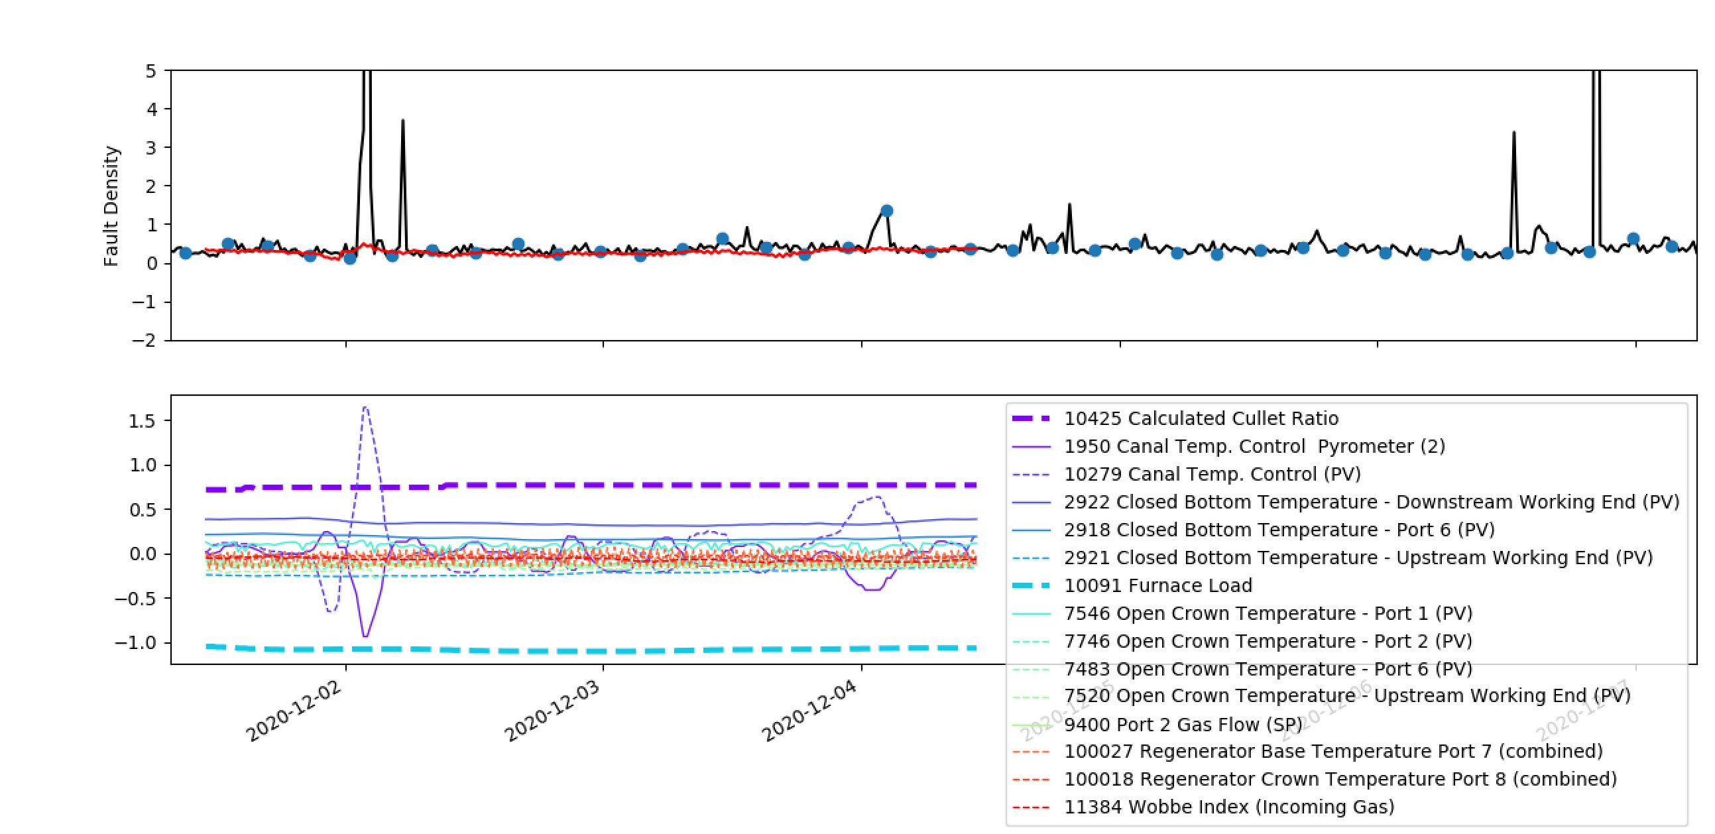
Linear Regression (Reduced Inputs)
Period 3 (7th December – 12th December)
A bit earlier that the period we’re interested in but it demonstrates this behaviour again…

Slide 7
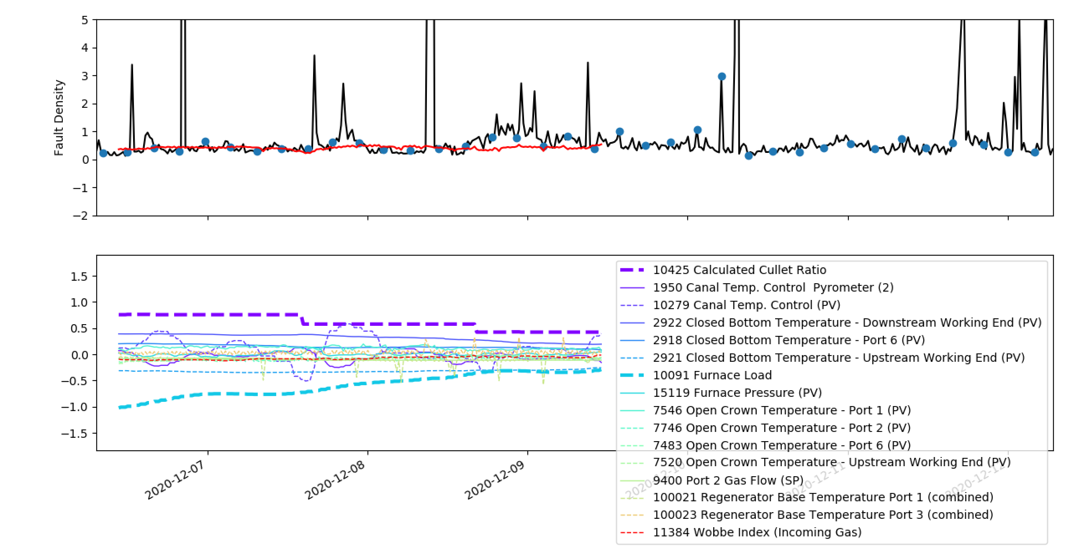
Linear Regression (Reduced Inputs)
Period 3 (7th December – 12th December)

Slide 8
Clustering
With the current model (I think) we still need to address issues around
Fault density data quality (actually stops us from using more complex models too)
Trade-off between complexity and interpretability
Addressing future unknown inputs (Linear Dynamical System)
Transformation into a decision making aid (which variables can be manipulated etc.)
I have some concerns over the oscillations in the combined tags – would be good to look at this again.
A simpler question: “Based on previous data, is the furnace in a ‘good’ or ‘bad’ state”?
Follow-up question: “What do we need to do to keep it in a ‘good’ state?”

Slide 9
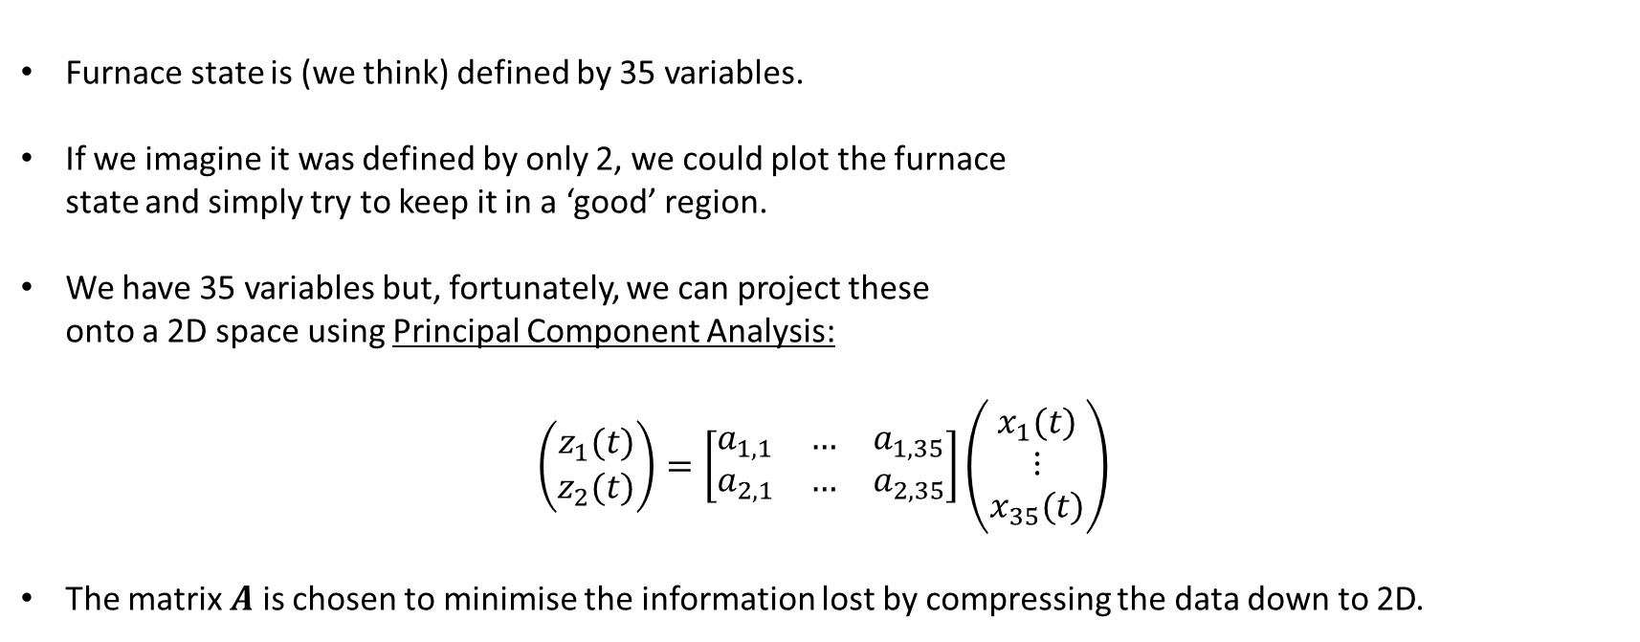
Clustering
Good
Furnace state is (we think) defined by 35 variables.
If we imagine it was defined by only 2, we could plot the furnace state and simply try to keep it in a ‘good’ region.
We have 35 variables but, fortunately, we can project these onto a 2D space using Principal Component Analysis:
$$\left(\begin{matrix}z_{1}(t) \\ z_{2}(t)\end{matrix}\right)=\left[\begin{matrix}a_{1,1} & … & a_{1,35} \\ a_{2,1} & … & a_{2,35}\end{matrix}\right]\left(\begin{matrix}x_{1}(t) \\ ⋮ \\ x_{35}(t)\end{matrix}\right)$$
The matrix $A$ is chosen to minimise the information lost by compressing the data down to 2D.
Bad

Slide 10
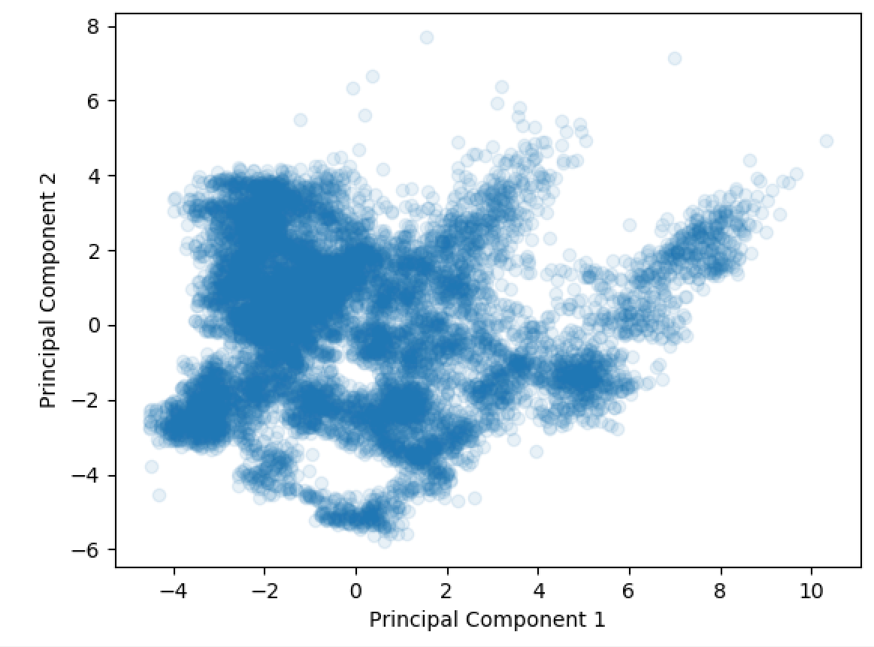
Clustering

Slide 11
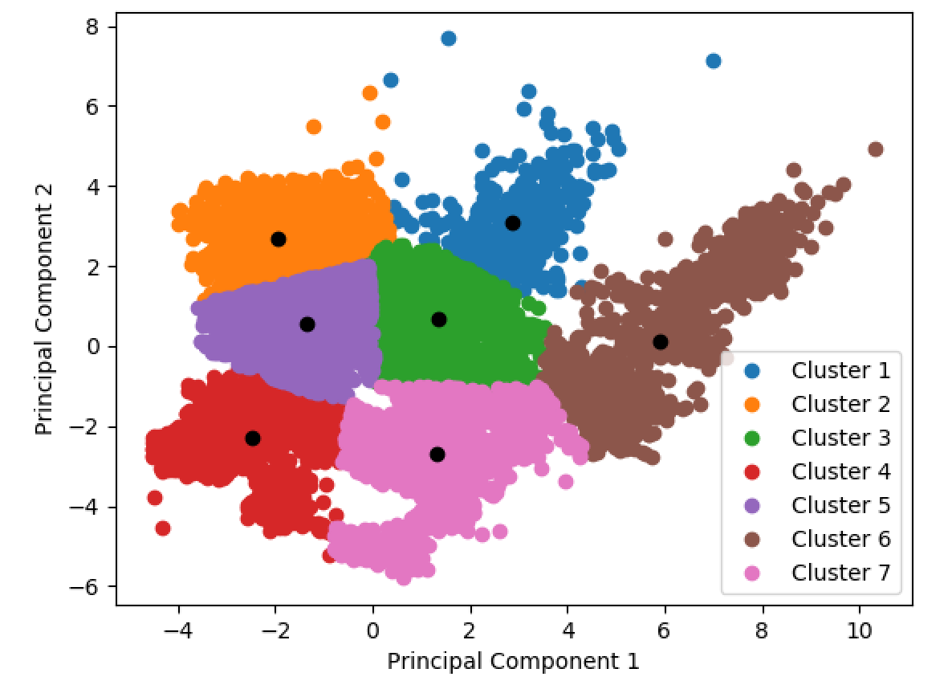
Clustering

Slide 12
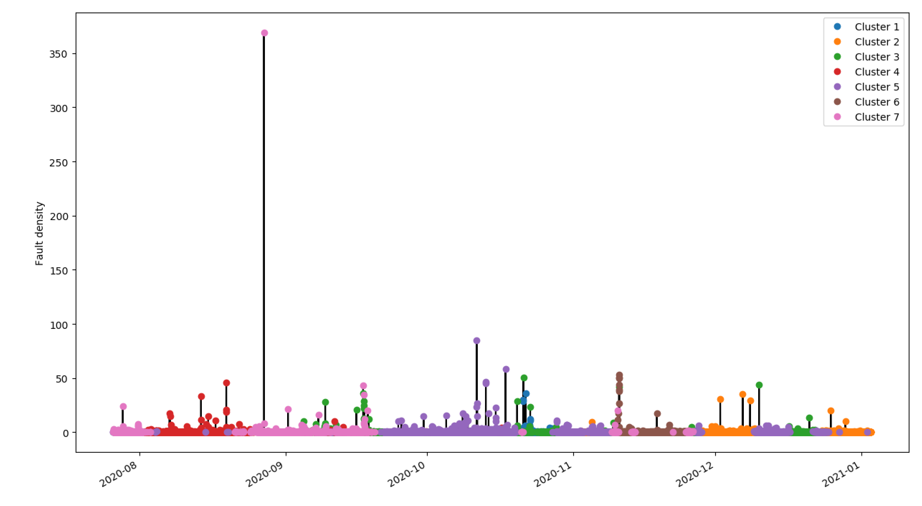
Clustering

Slide 13
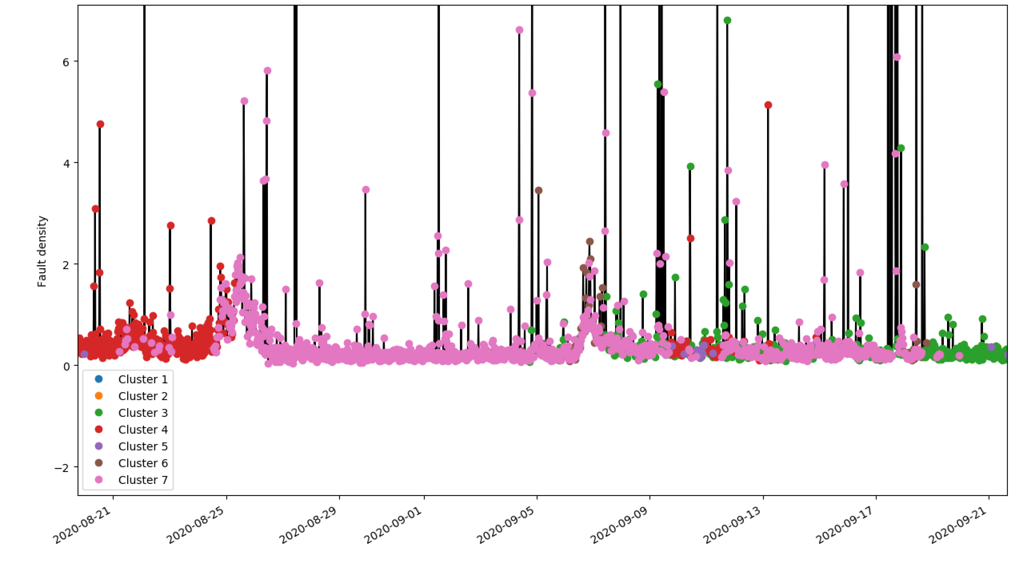
Clustering

Slide 14
Clustering
23rd – 27th August
6th – 9th September
(key regions of fault density)

Slide 15
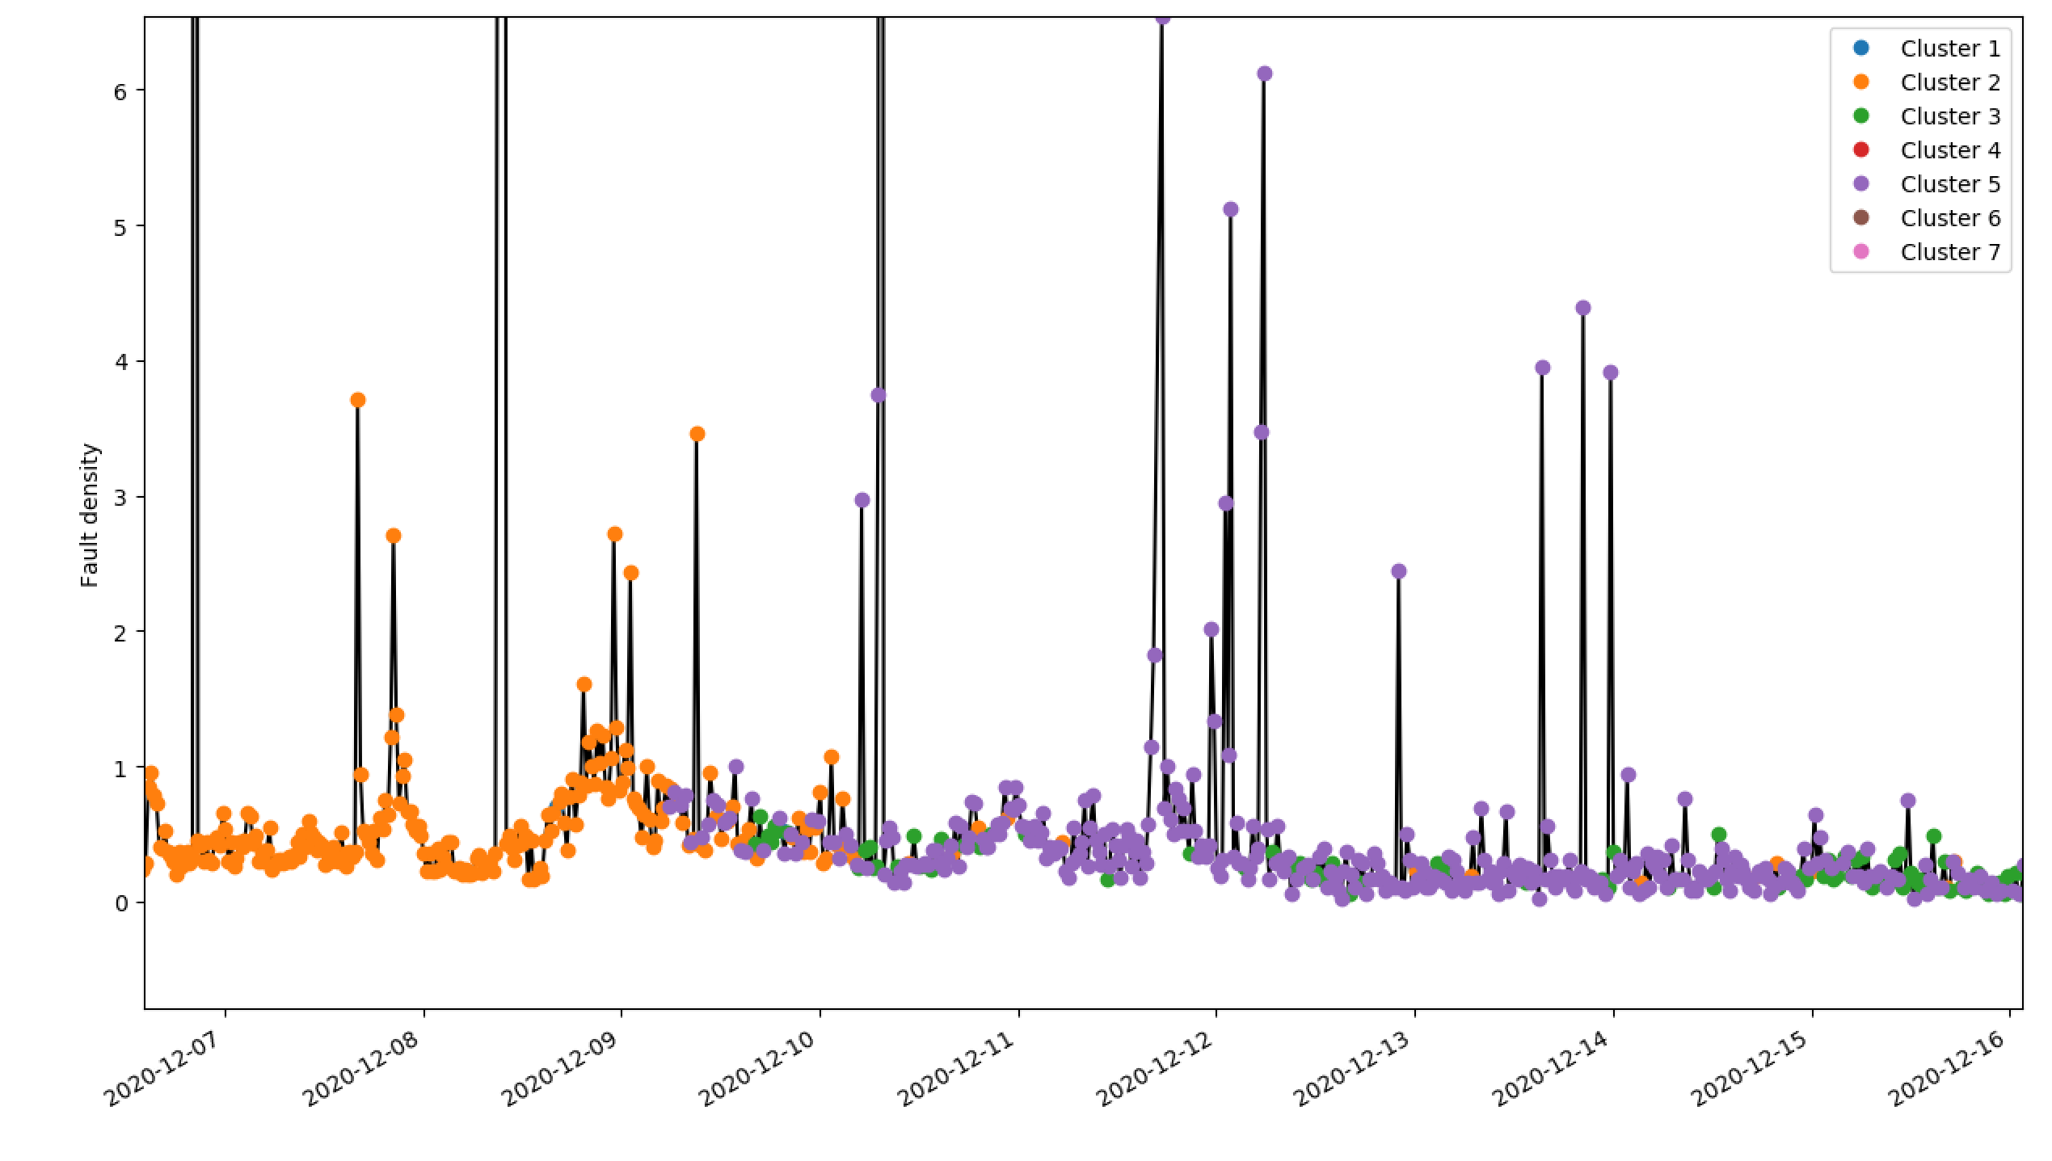
Clustering
7th – 12th December
(key regions of fault density)

Slide 16
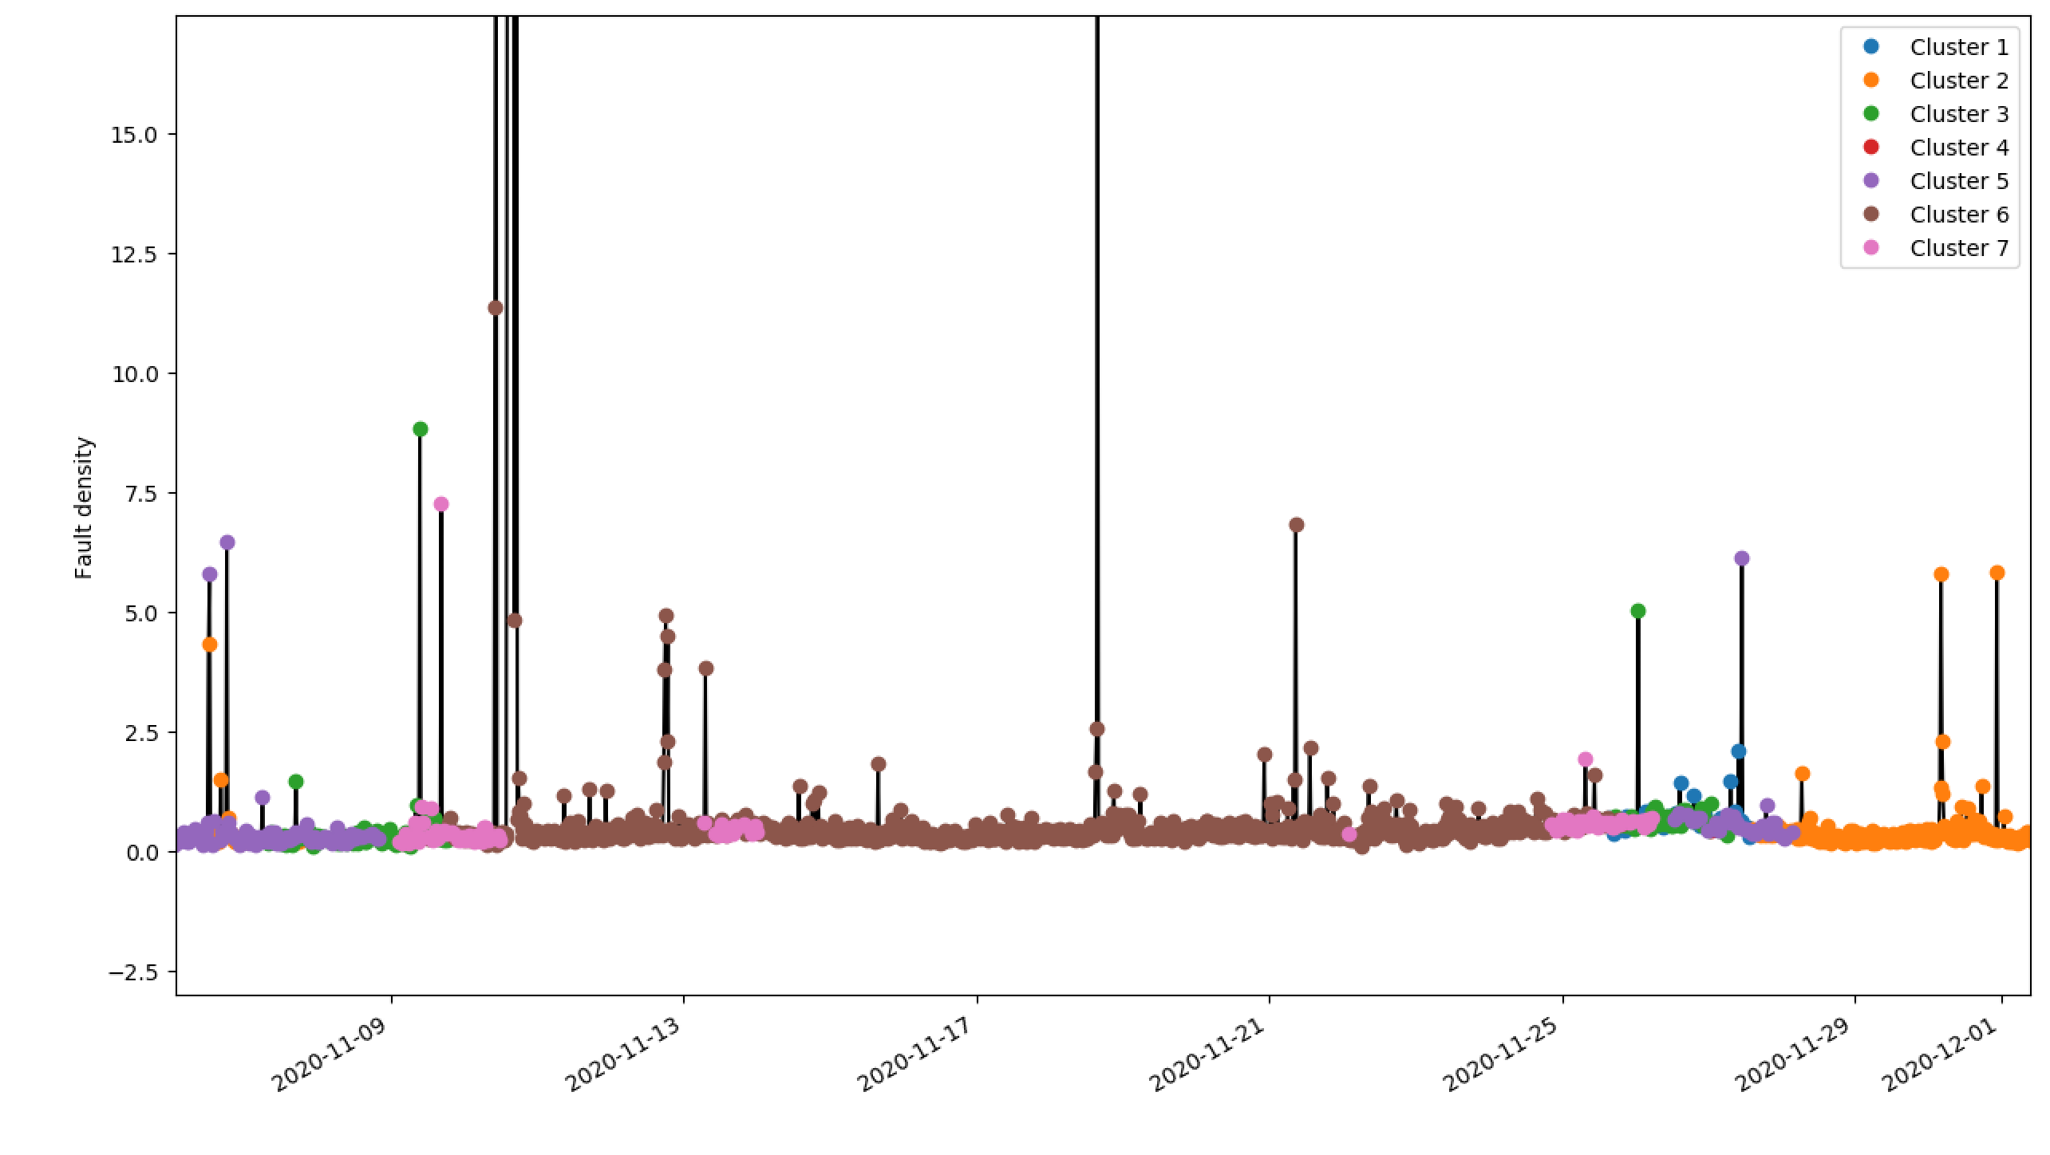
Clustering
Good region…

Slide 17
Clustering
Current state…

Slide 18
Clustering
Propose a change in load (all else equal)

Slide 19
Clustering
We want to keep the furnace state here

Slide 20
Clustering
Identify the ranges of tag inputs that would keep the model in this region.
Note that the approach only deals with tag data i.e. furnace state. We could use the furnace fault data to label ‘bad’ regions though.
Obviously this approach could be made more sophisticated.

Slide 21
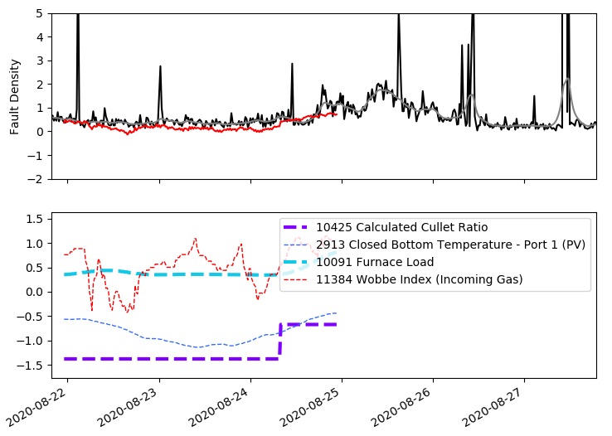
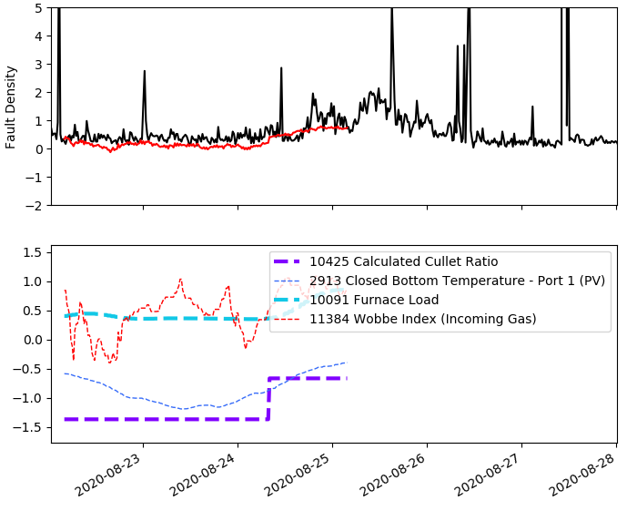
Processing Furnace Faults
Pre-processed furnace faults
Raw furnace faults

Slide 22
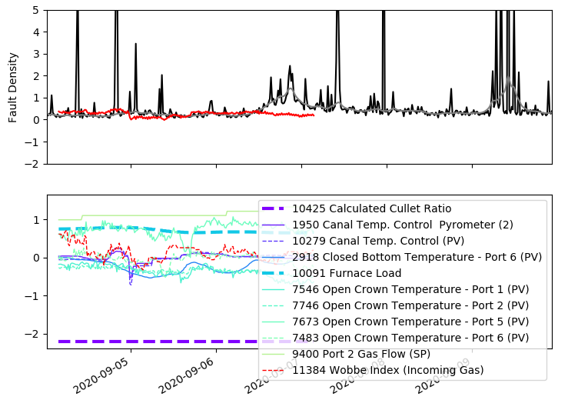
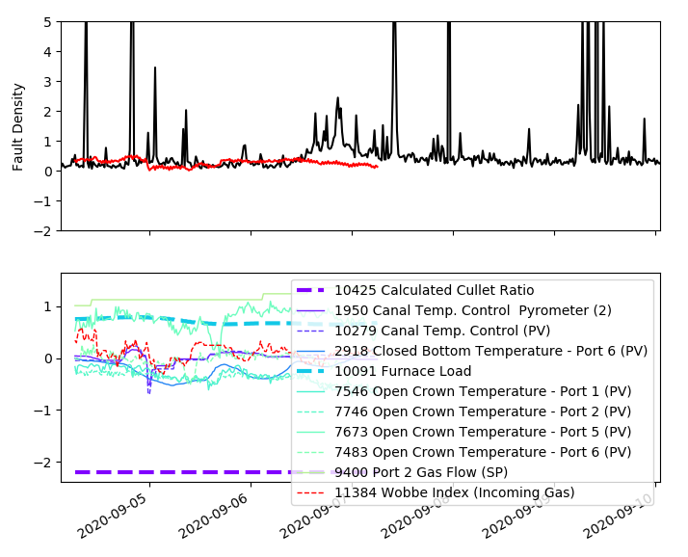
Processing Furnace Faults
Pre-processed furnace faults
Raw furnace faults

Slide 23
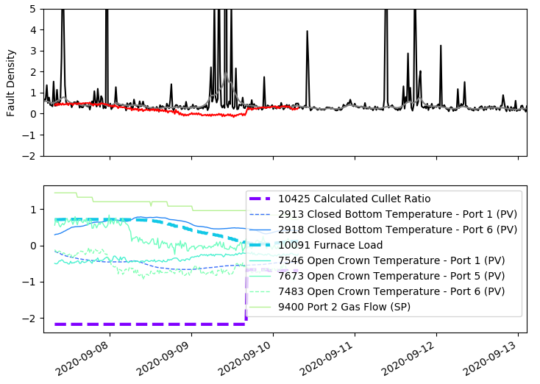
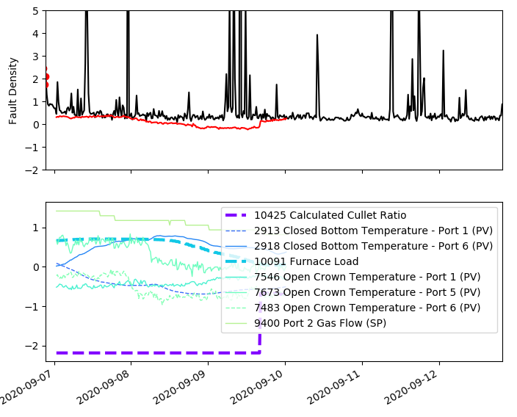
Processing Furnace Faults
Pre-processed furnace faults
Raw furnace faults

Slide 24
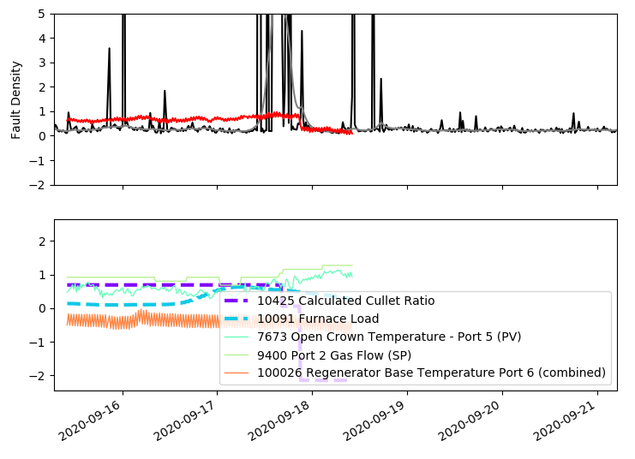
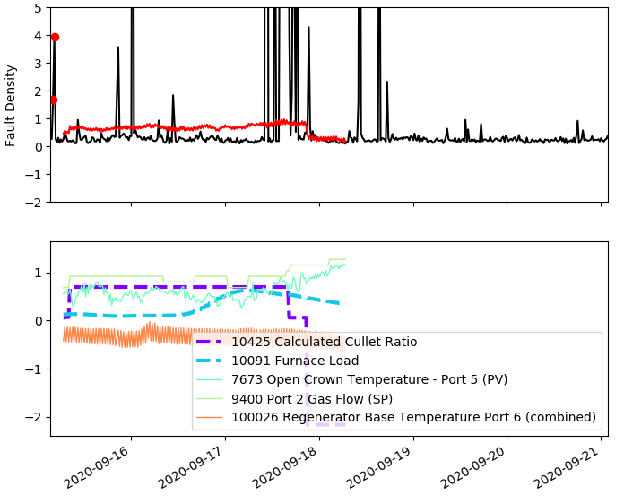
Processing Furnace Faults
Pre-processed furnace faults
Raw furnace faults

Slide 25
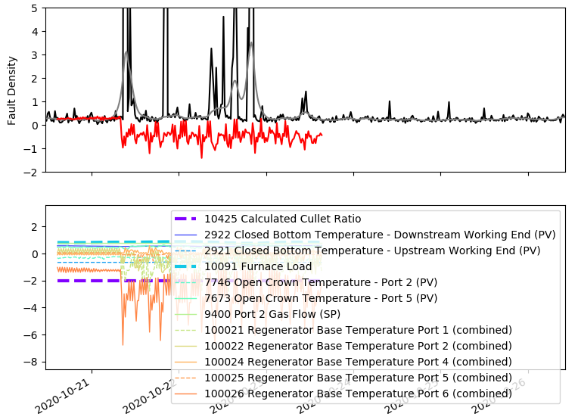
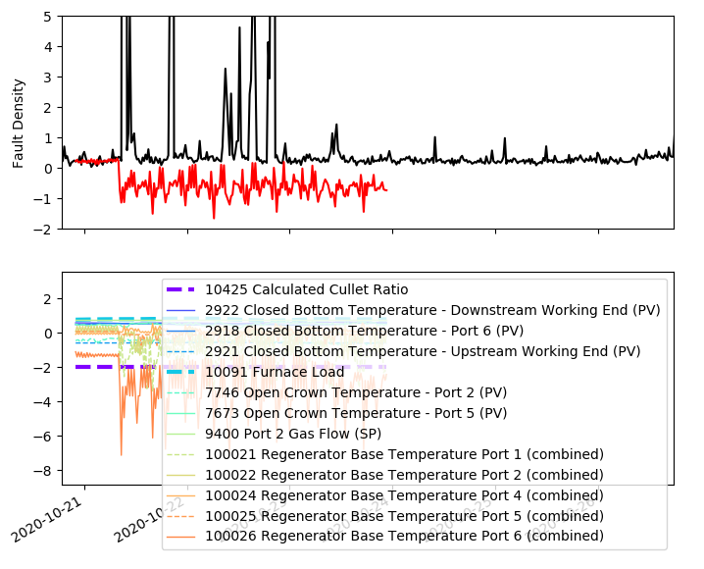
Processing Furnace Faults
Pre-processed furnace faults
Raw furnace faults

Slide 26
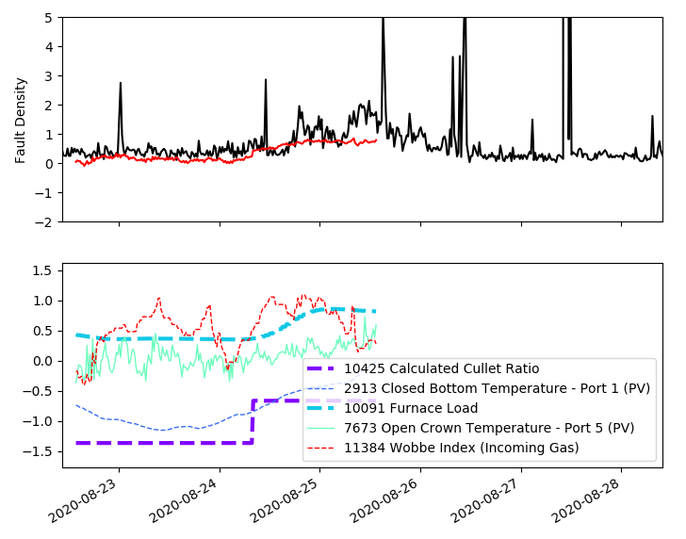
Processing Furnace Faults
Both furnace load and furnace fault density are increasing

Slide 27
Processing Furnace Faults
Furnace load is decreasing but fault density is increasing

Slide 28
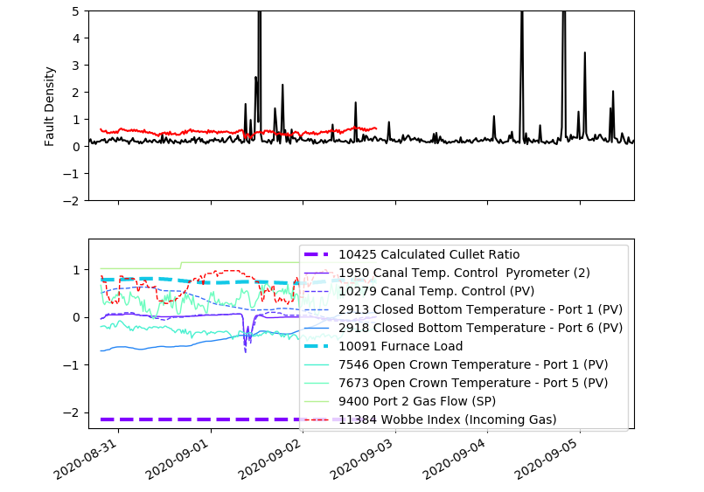
Processing Furnace Faults
Furnace load is relatively high but furnace faults is relatively low

Slide 29
Time lags estimation
1) Good assumption of what we belief is the real fault density.
2) The time lags can be tunned by finding the relation (Linear Regression) between the tags and the fault density that provide the lowest MSE.
To achieve 1) we use a complex Machine Learning technique based on Dirichlet Process (DP) clustering and Gaussian Process (GP) regression.
Batch regression:
Given the high complexity of the fault density (Outliers, rapid increases, slow and rapid increases at different scales, slow trends, etc), the model has been trained by regions.

Slide 30
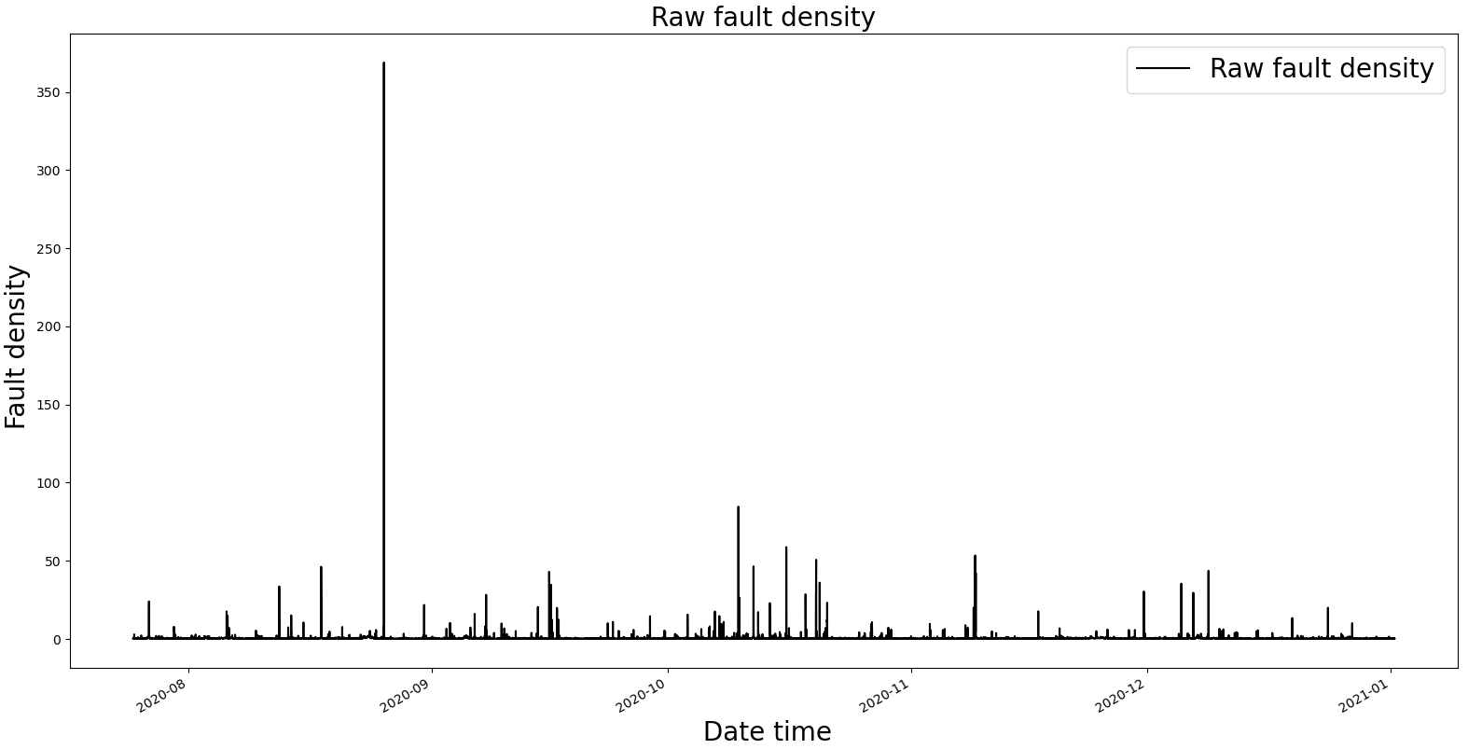
Automatic outlier identification

Slide 31
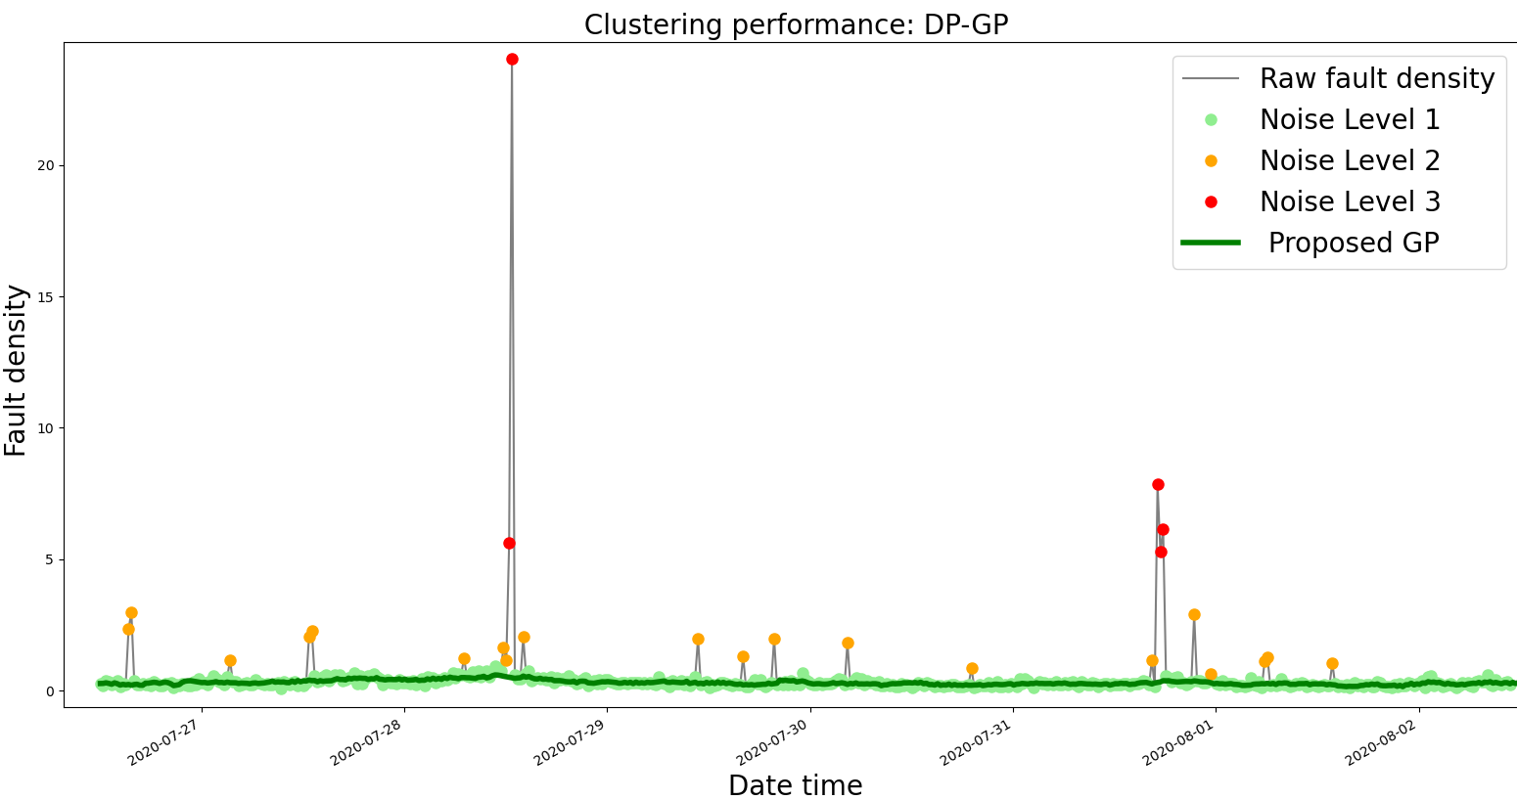
Automatic outlier identification
500 points

Slide 32
Automatic outlier identification

Slide 33
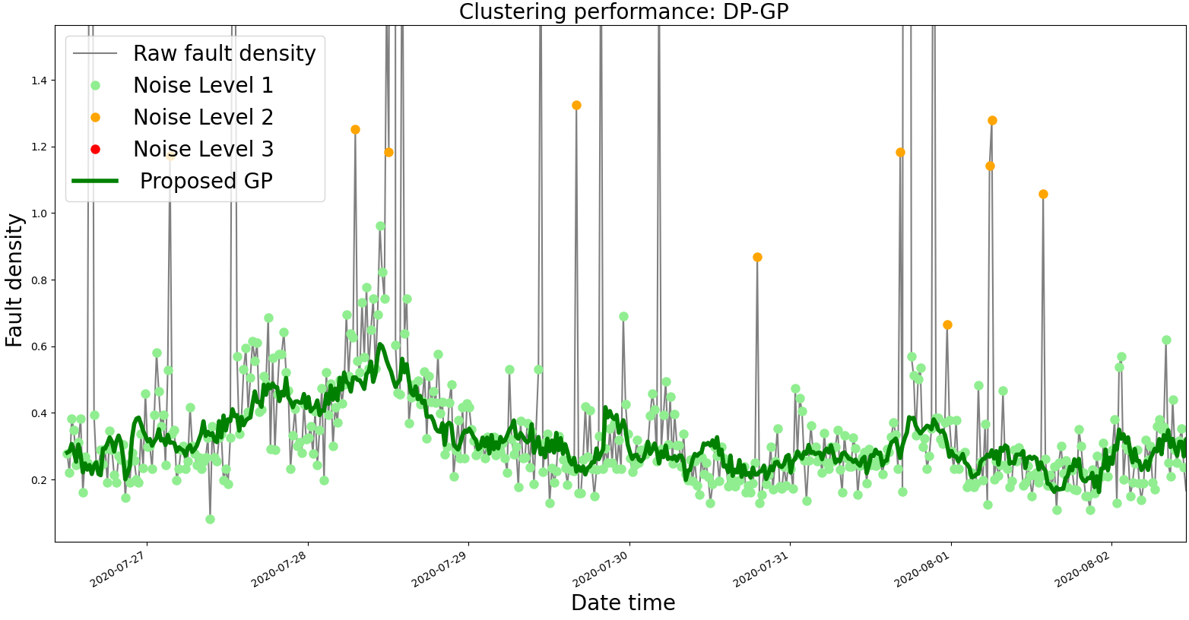
Automatic outlier identification

Slide 34
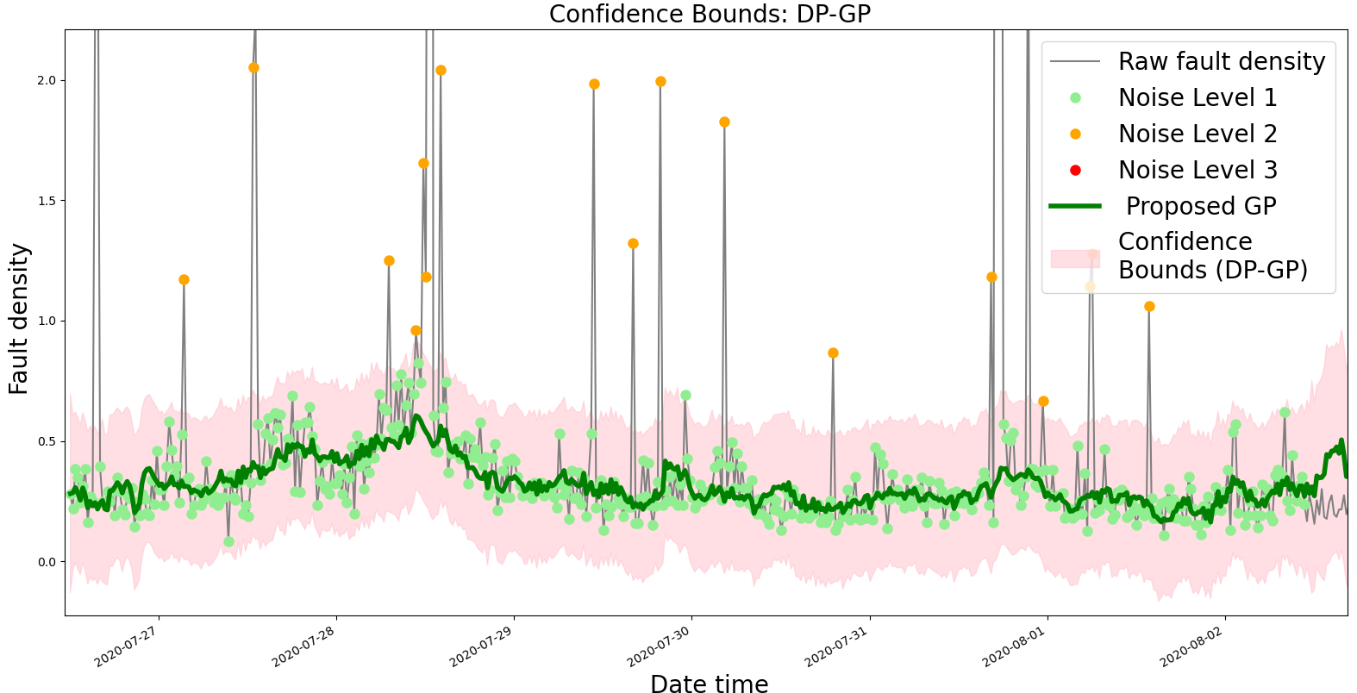
Automatic outlier identification

Slide 35
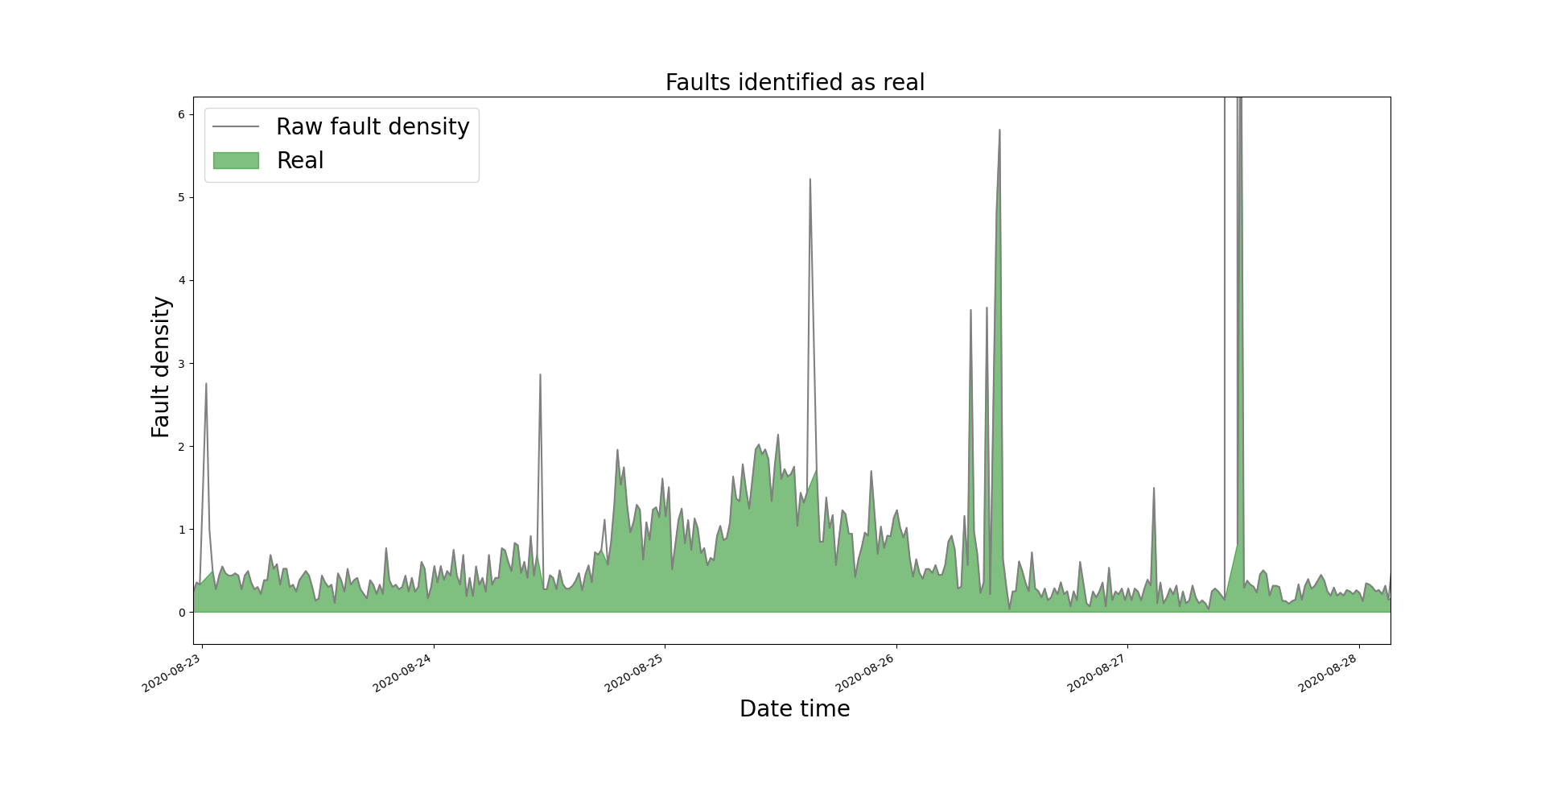
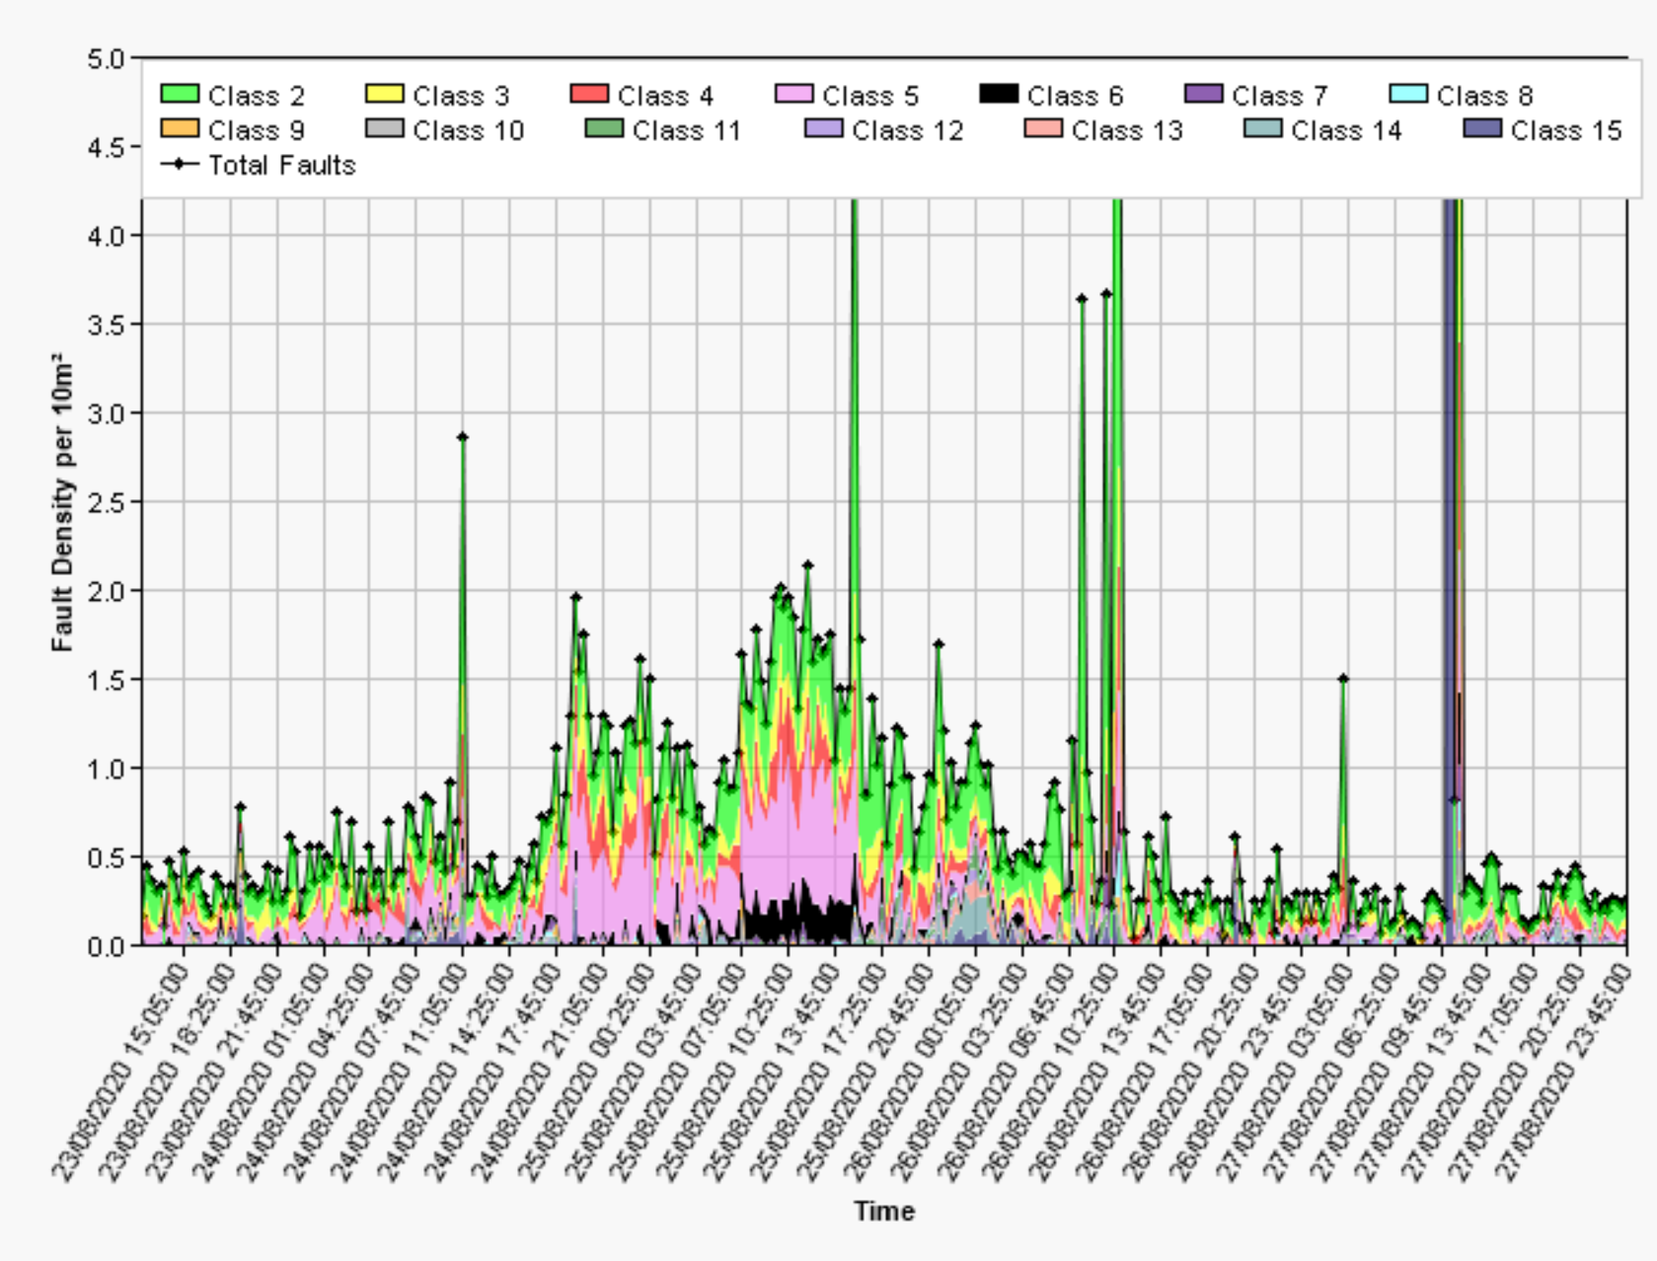
Automatic outlier identification
Fault density increase: 23 – 28 August 2020

Slide 36
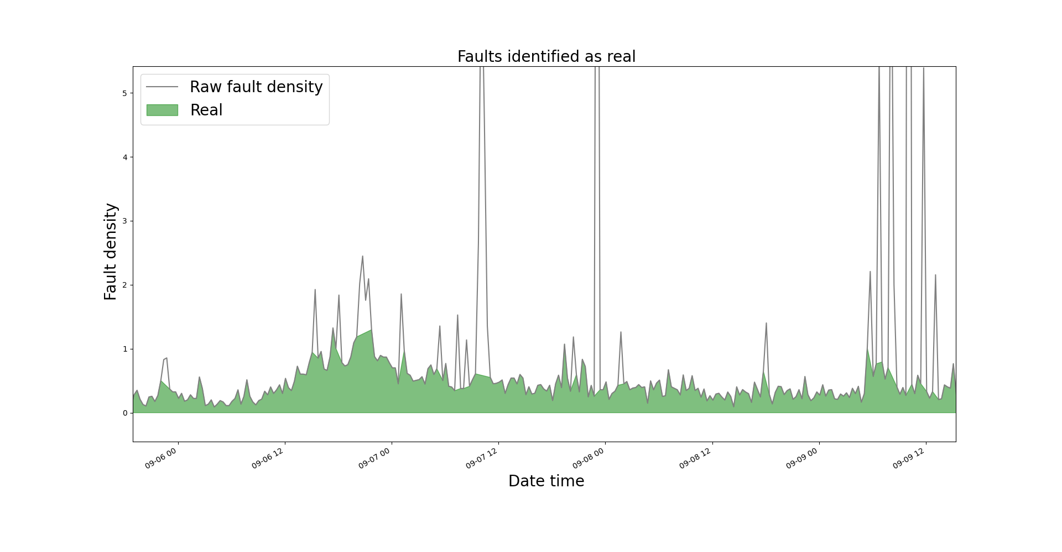
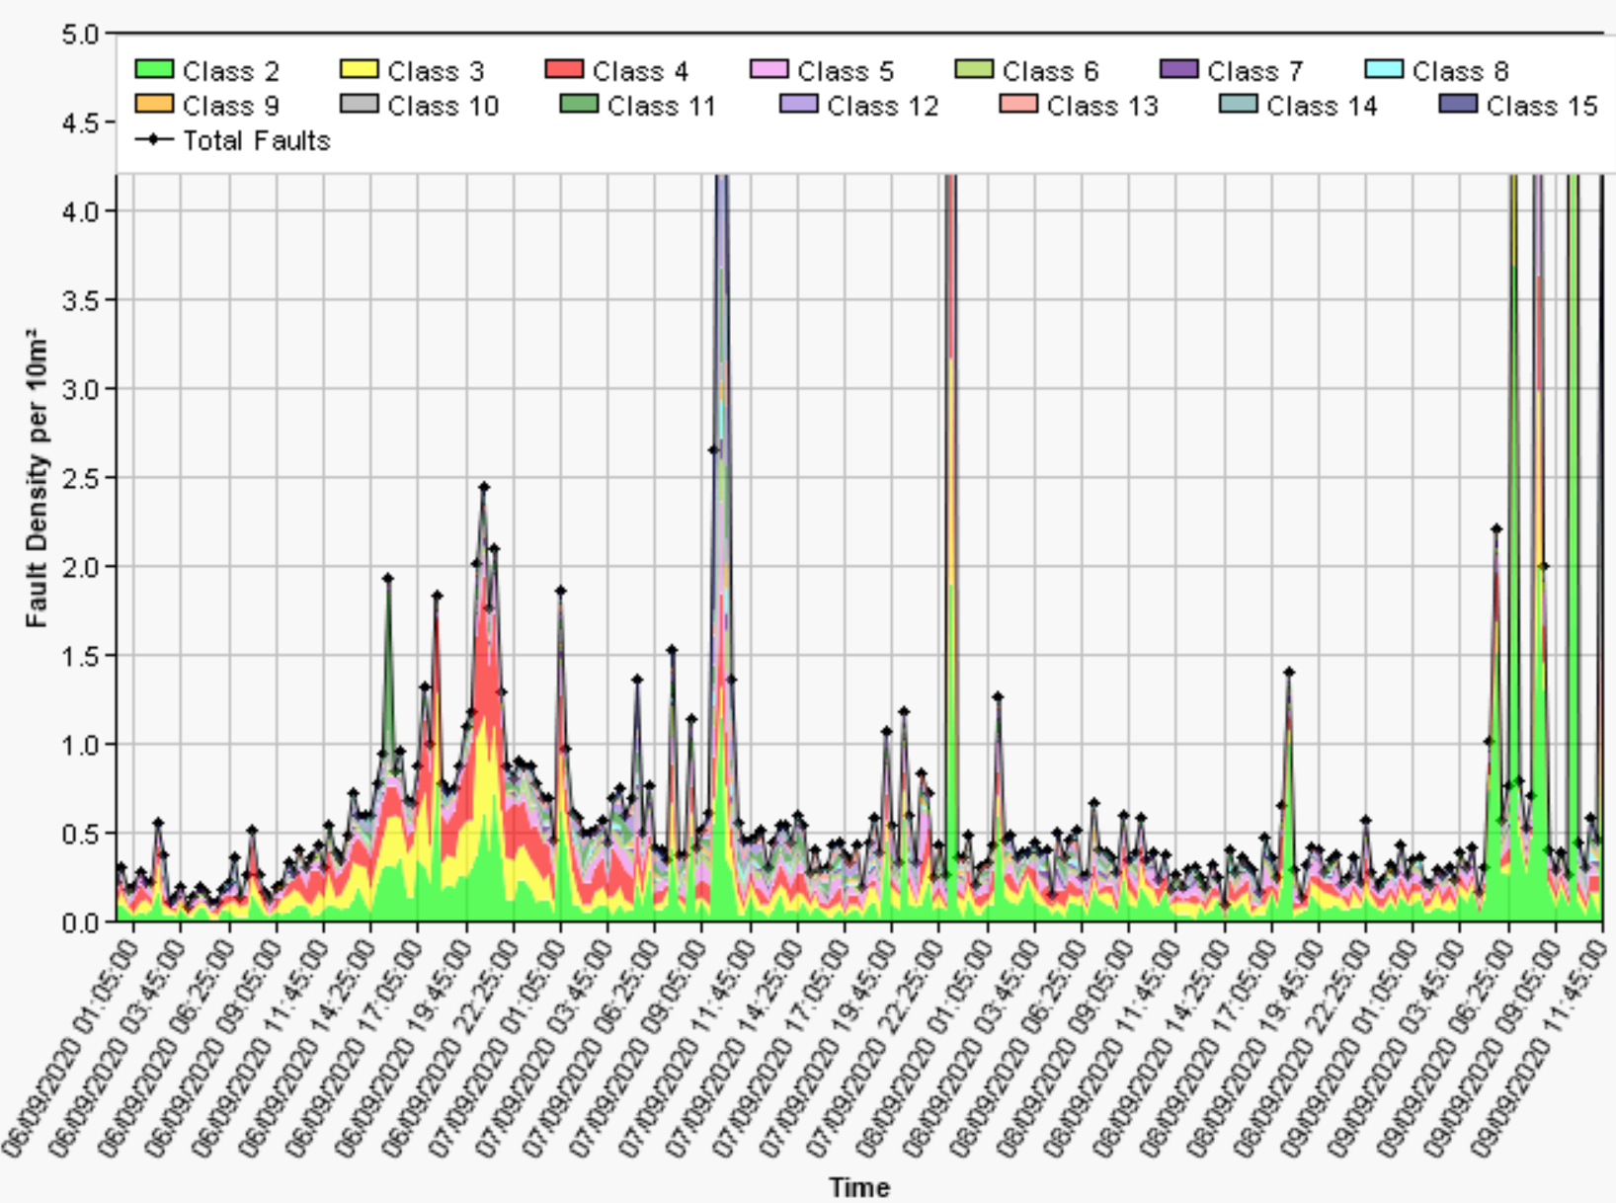
Automatic outlier identification
Fault density increase: 06 – 09 August 2020

Slide 37
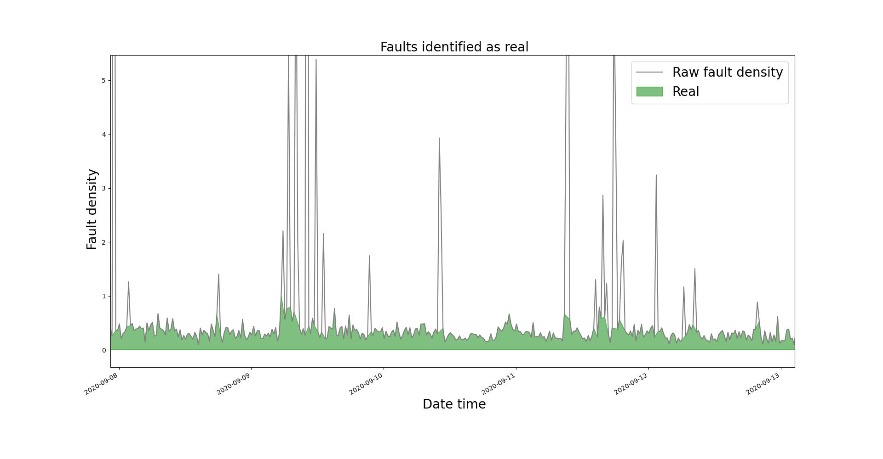
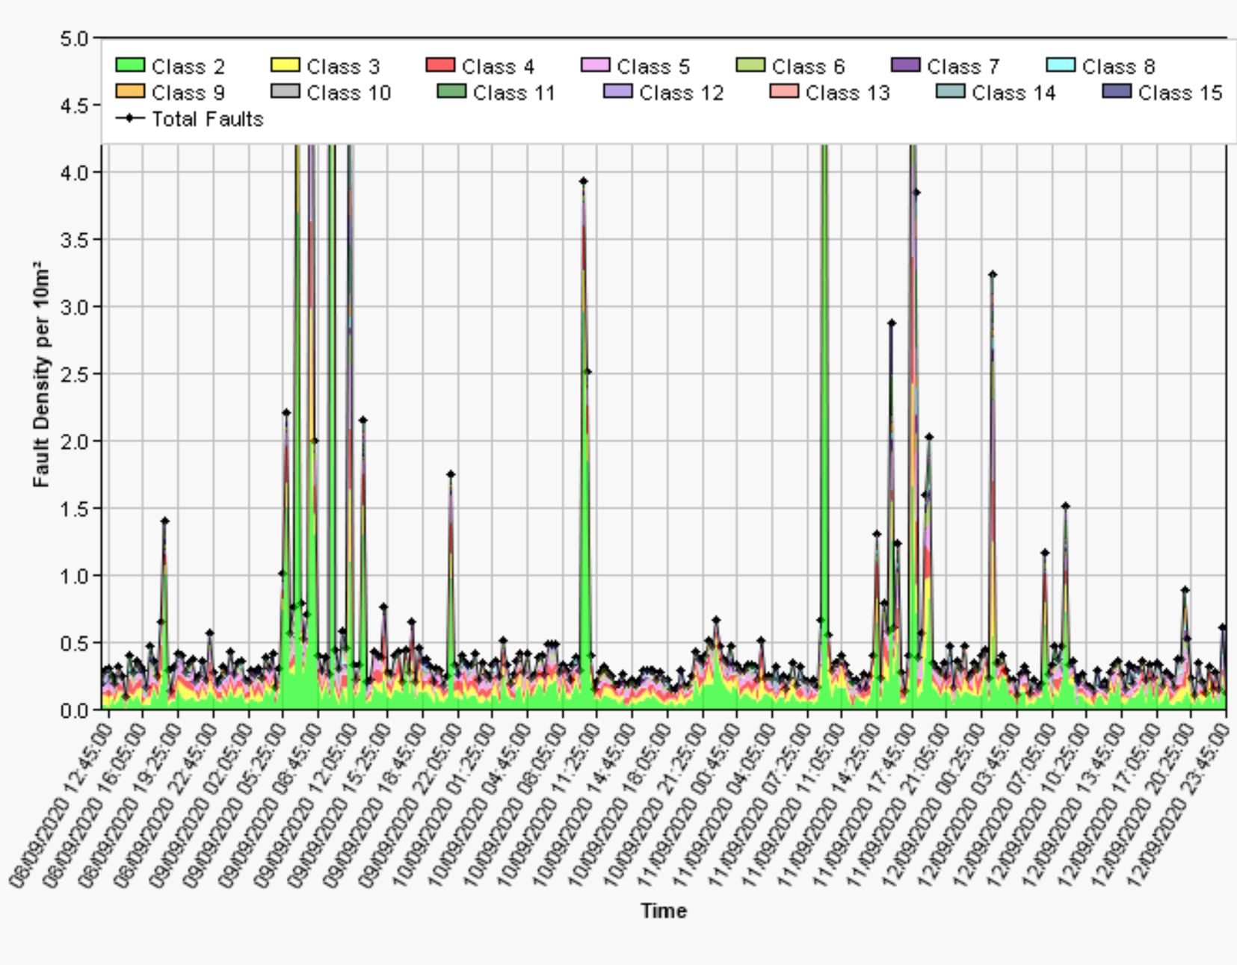
Automatic outlier identification
Fault density increase: 08 – 13 August 2020

Slide 38
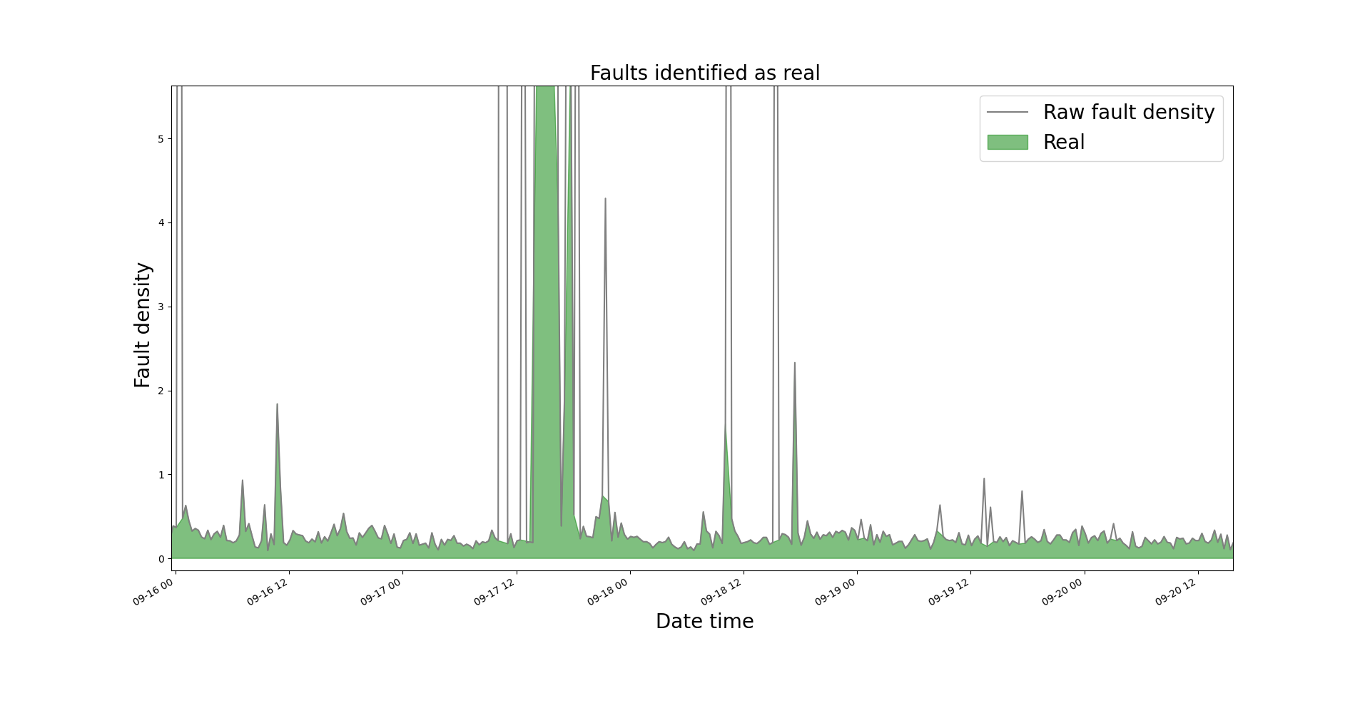
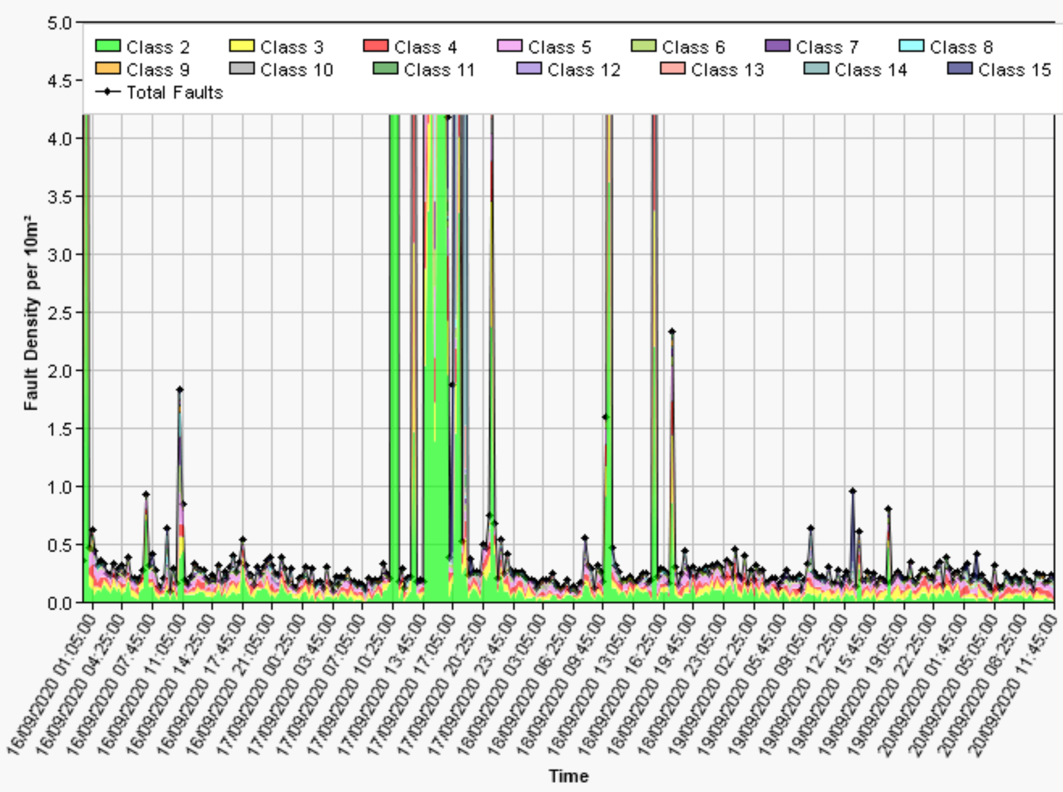
Automatic outlier identification
Fault density increase: 16 – 20 September 2020

Slide 39
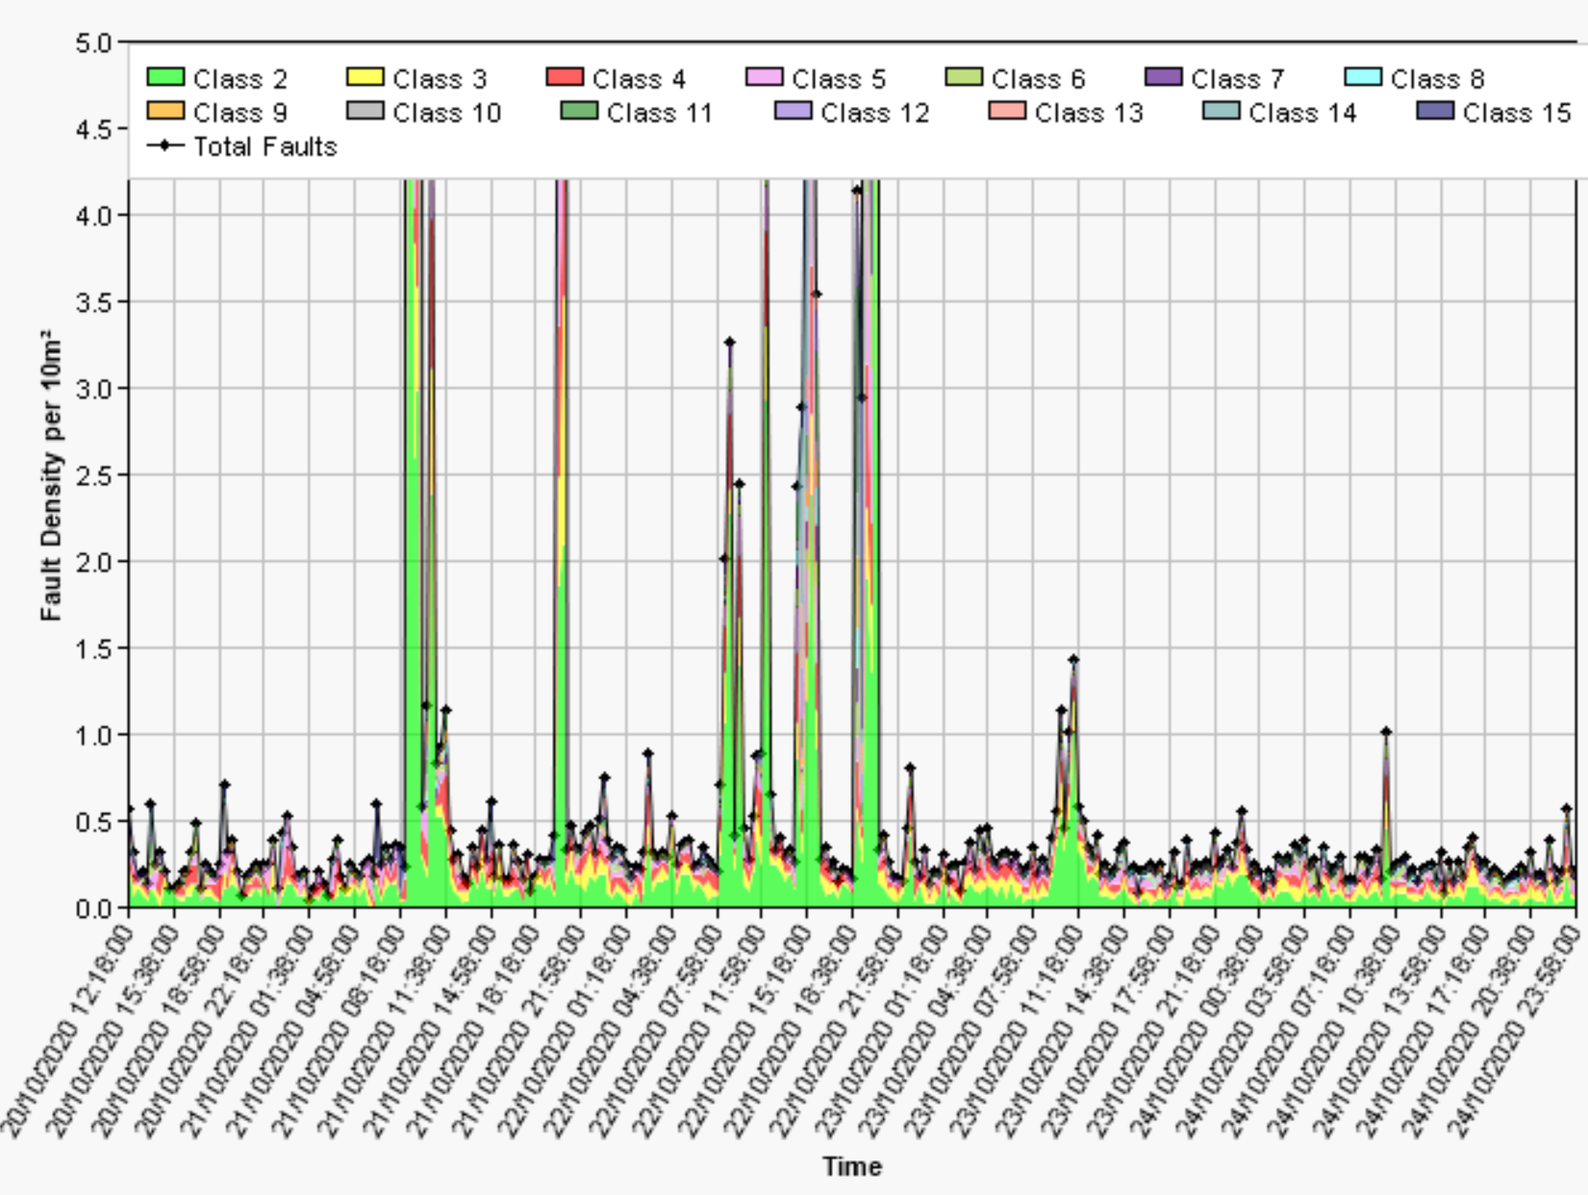
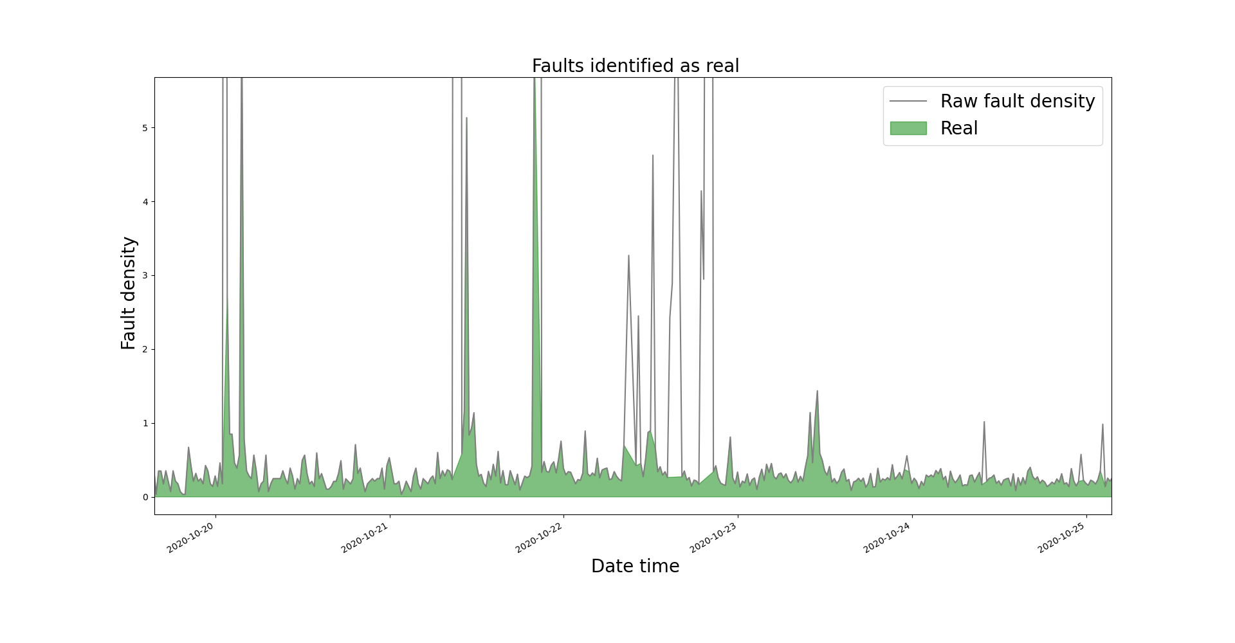
Automatic outlier identification
Fault density increase: 20 – 25 October 2020

Slide 40
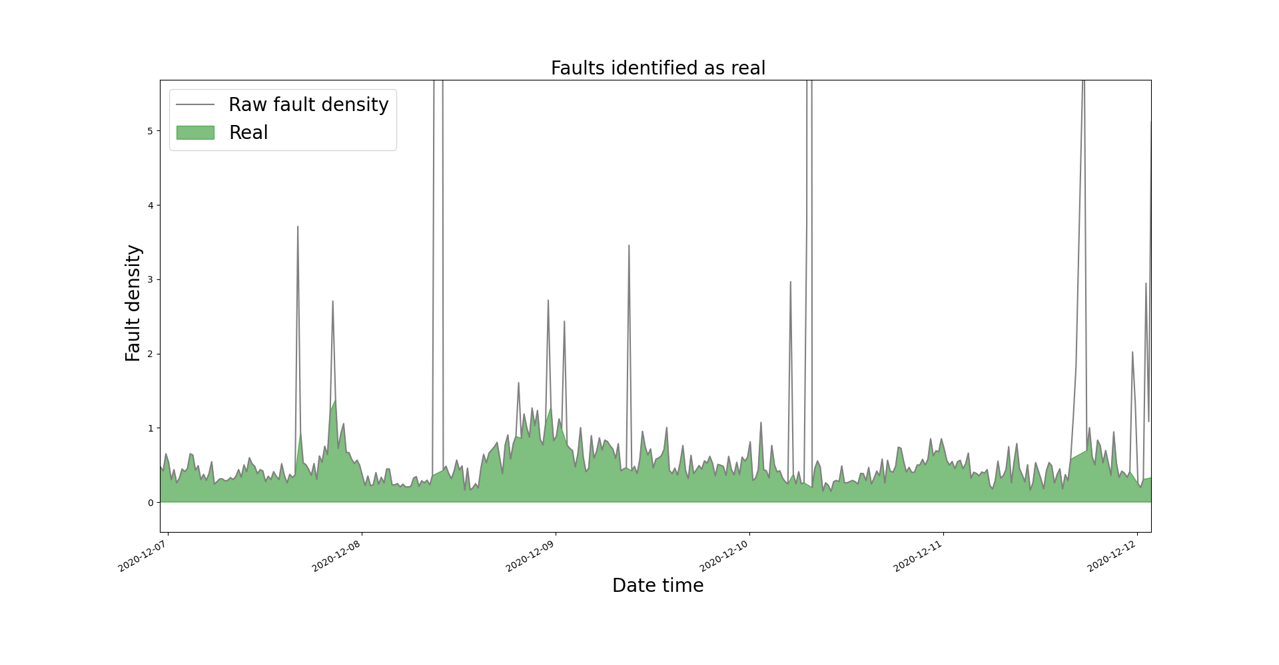
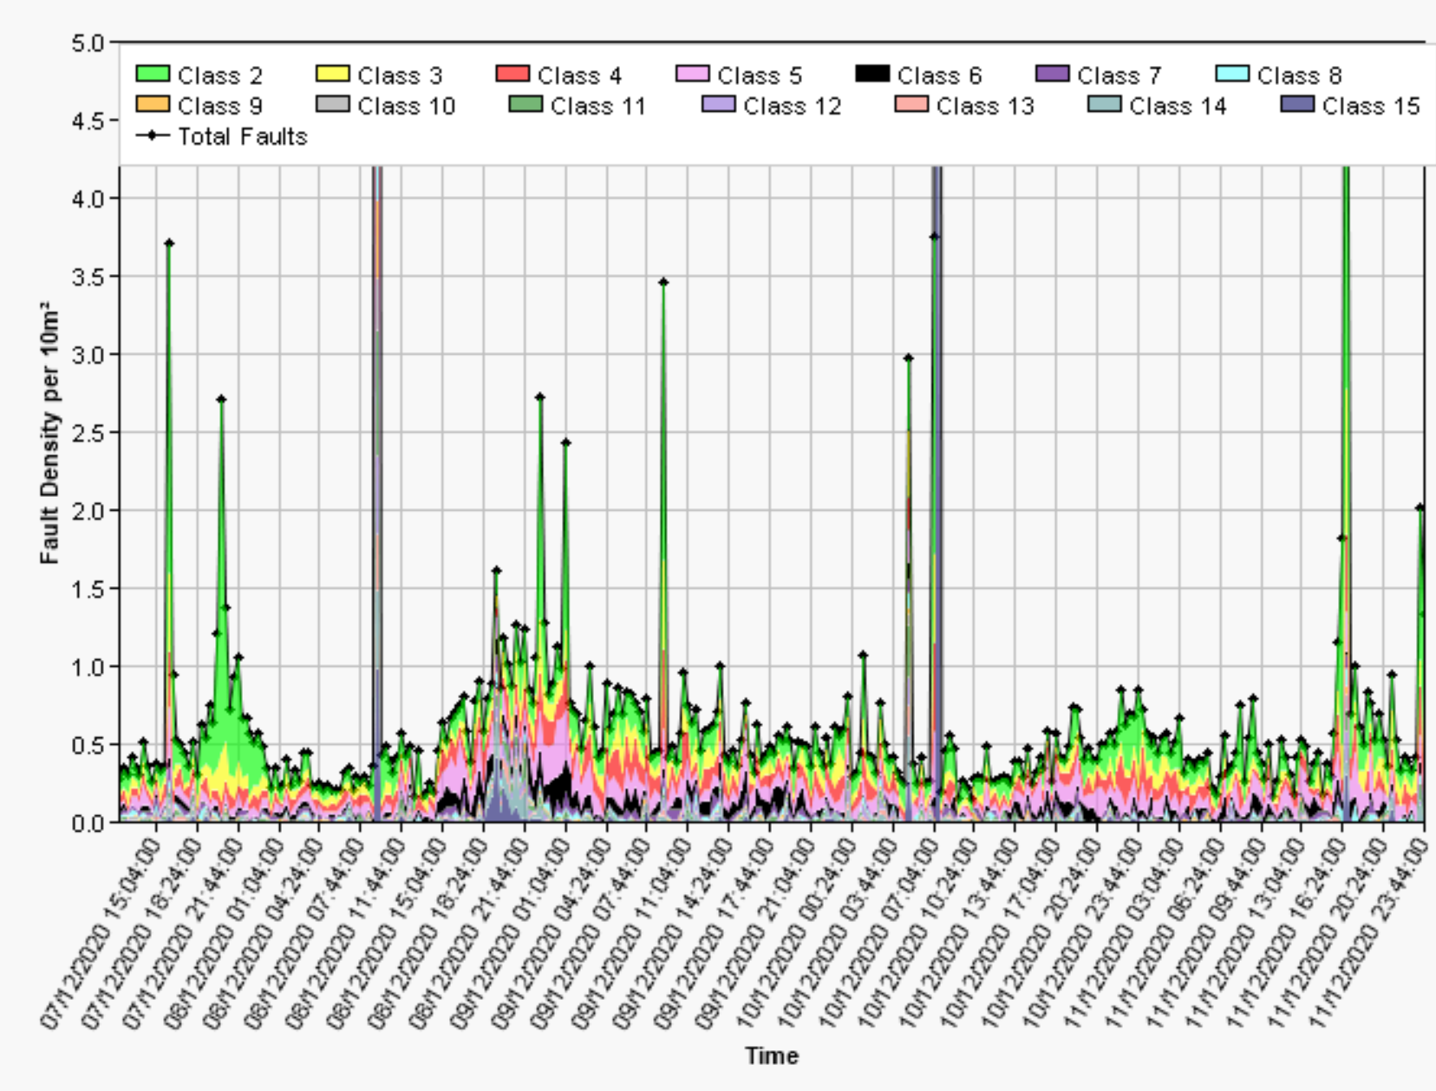
Automatic outlier identification
Fault density increase: 07 – 12 December 2020

Slide 41
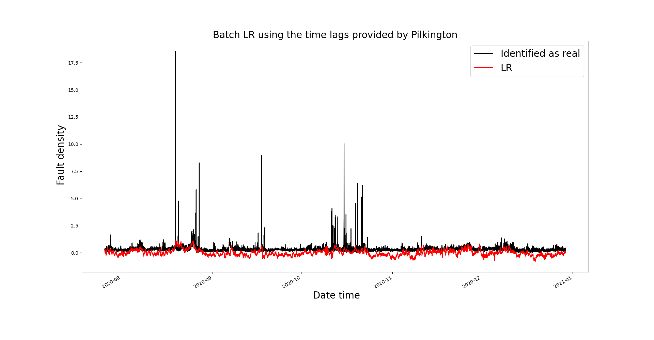
Automatic outlier identification
Full data and LR using the time lags provided by Pilkington

Slide 42
Time lags estimation
We can now apply the time lags estimation strategy detailed in previous presentations.
N = 5000 simulations will be run to account a wide time lags combination.
Given that this task is time consuming, we will provide the set of estimated time lags tomorrow 15 April 2021.

Slide 43
Thank you for your attention. ANY QUESTIONS?

